Slide 1
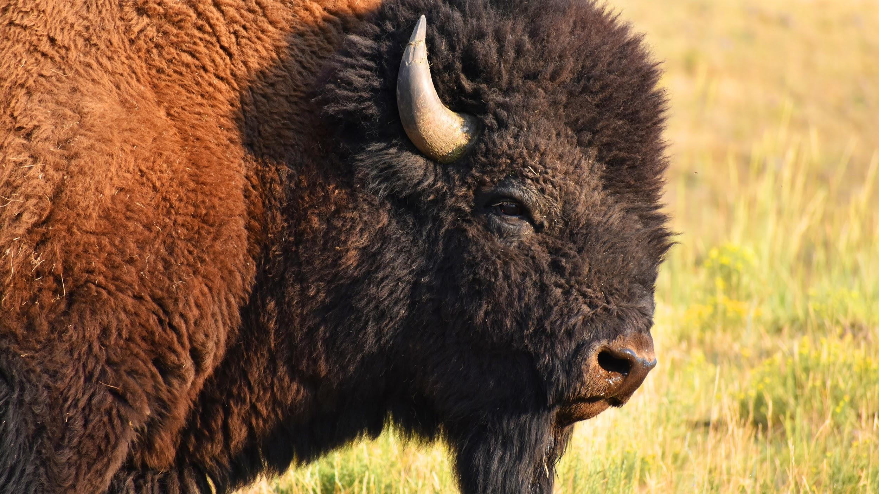
Version 3.0
BuffaloFieldCampaign.Org
Protect Our National Mammal Campaign
American Bison: An Endangered Species

Slide 2
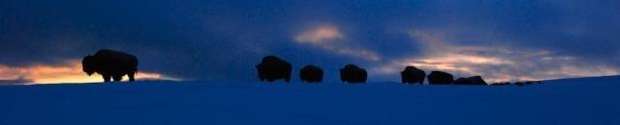
Goals
Raise public awareness of the 2016 designation by Congress of the American Bison as Our National Mammal
Motivate and inspire action to recover wild American bison in the Yellowstone ecosystem and protect their habitat
Gain new members and allies by highlighting the importance of wild buffalo and the work of BFC
BuffaloFieldCampaign.Org

Slide 3
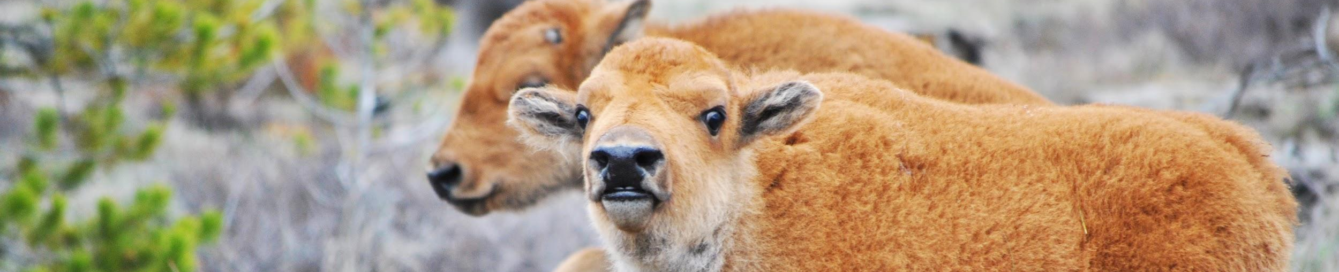
How would we like our audience to feel?
Informed, educated and emotionally invested in the well being of the Yellowstone Bison
Have a clear understanding of current BFC issues and initiatives
Eager to engage and participate
Have a clear understanding of next steps
BuffaloFieldCampaign.Org

Slide 4
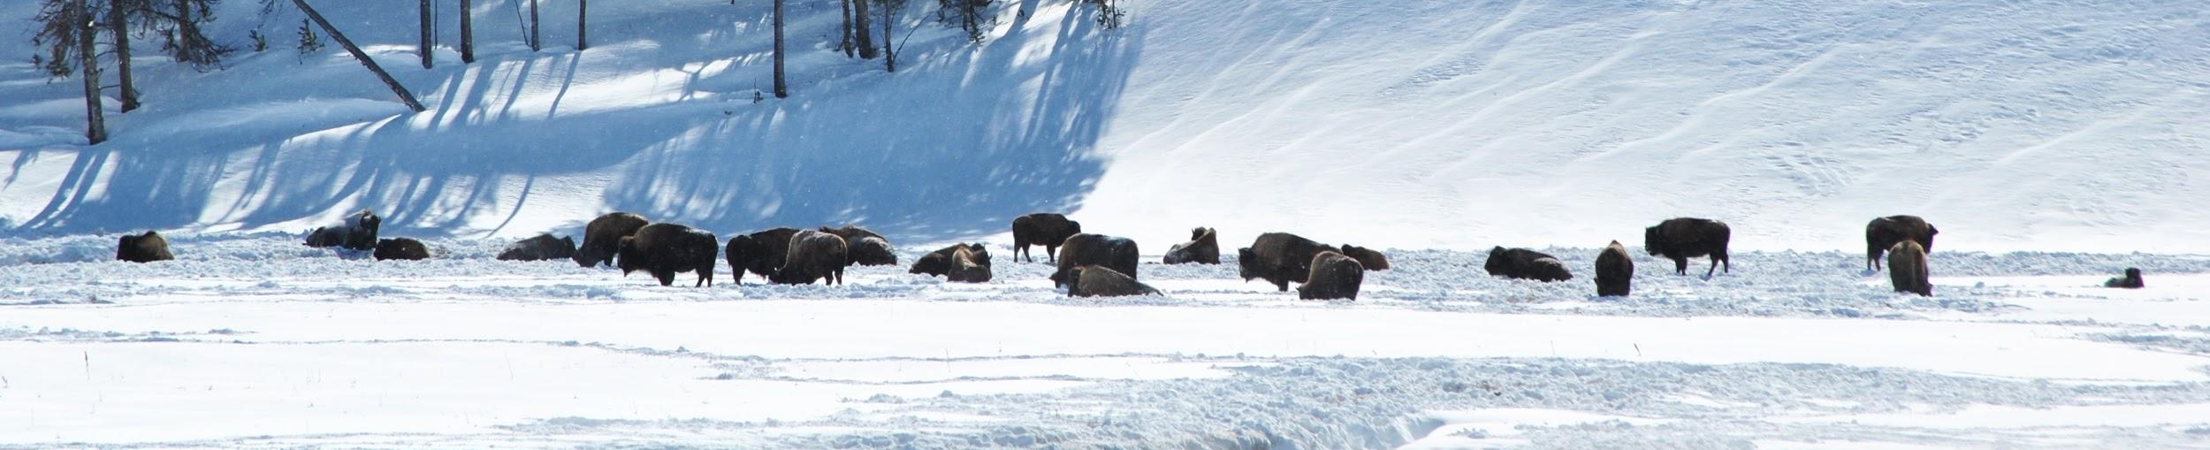
Who we are trying to reach
Native allies and Tribal peoples
Businesses
Tax paying citizens
American & Global audiences
Organized groups
Farmers and ranchers
BuffaloFieldCampaign.Org

Slide 5
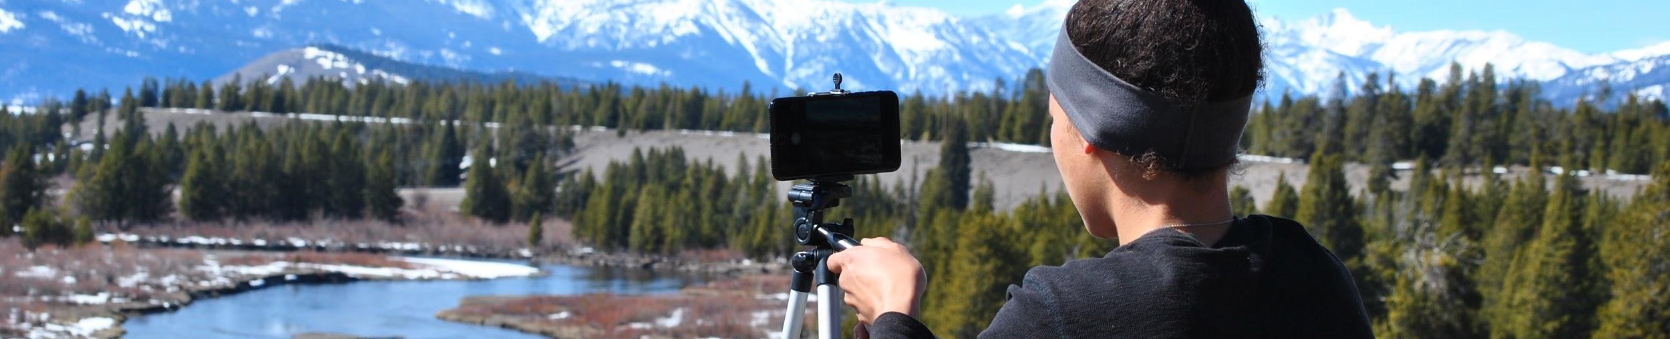
Approach
Deliver in-person presentations to each group or our target audience
Customize each presentation to the concerns of each group
Provide clear and simple talking points so each group can pass along and amplify our messag
Provide clear calls-to-action such that each group can support BFC initiatives
BuffaloFieldCampaign.Org

Slide 6
Version 3.0
BuffaloFieldCampaign.Org
Presentation Begins on Next Slide

Slide 7
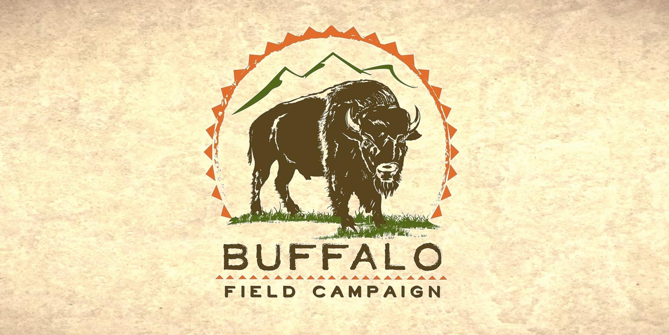
BuffaloFieldCampaign.Org
Notes:
[ Set up slide ]

Slide 8
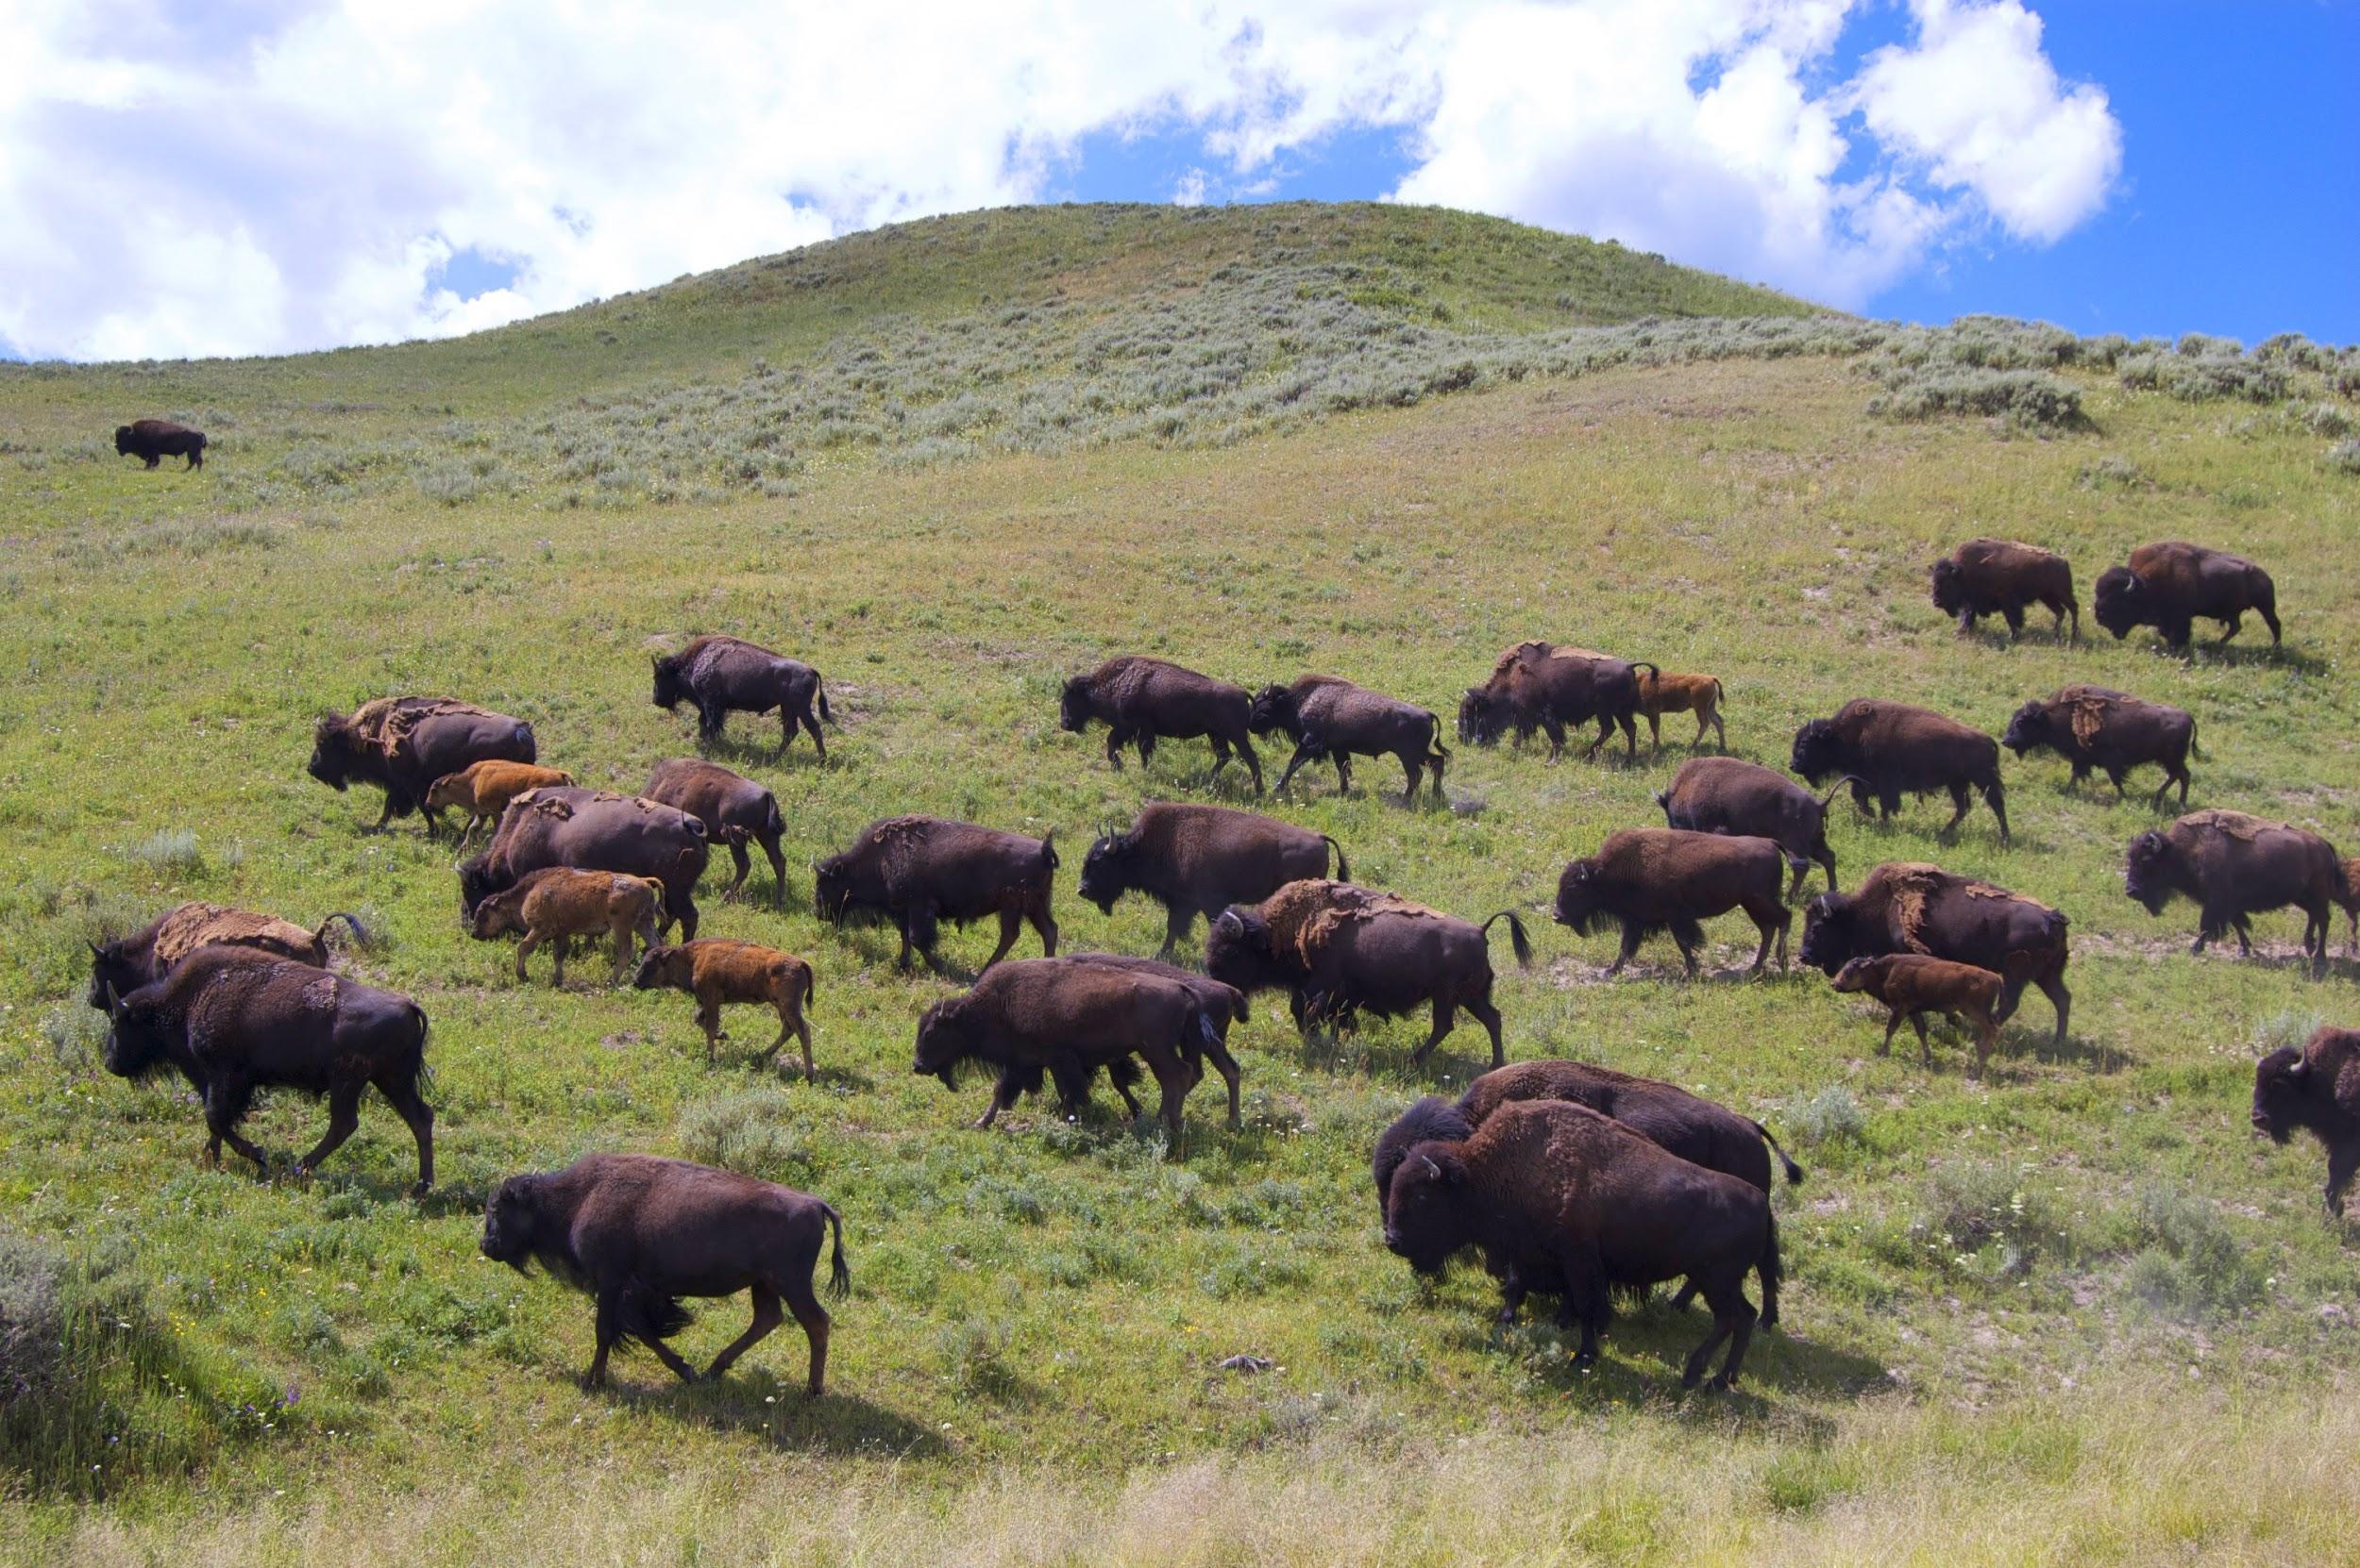
Version 3.0
BuffaloFieldCampaign.Org
America’s National Mammal
Notes:
SPEAKER:
( Personal introduction and introduction of Our National Mammal)

Slide 9
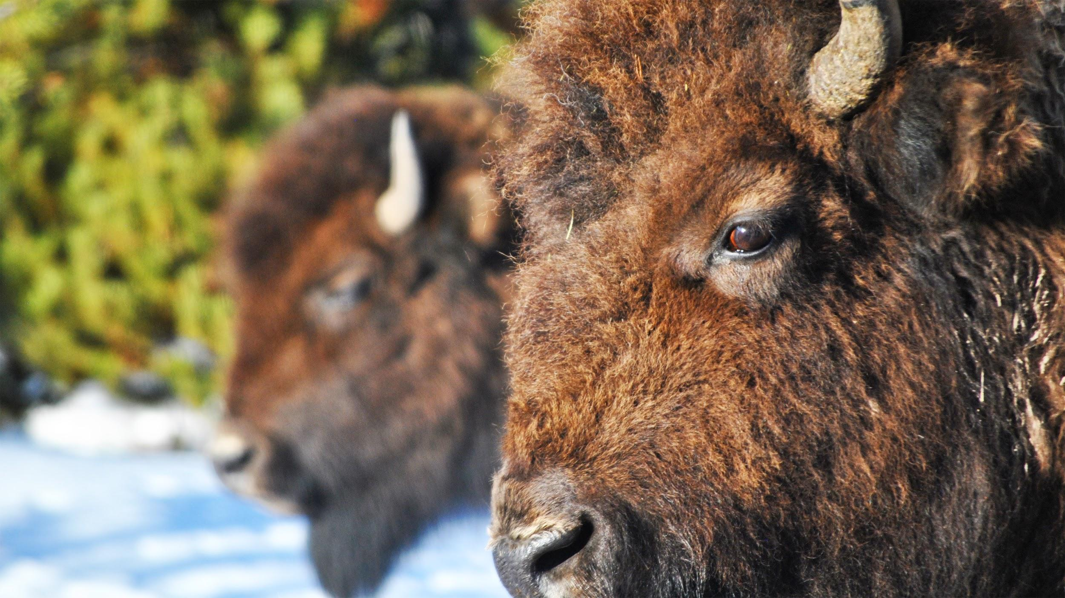
May 9, 2016
National Bison Legacy Act Signed Into Law
BuffaloFieldCampaign.Org
Notes:
On May 9, 2016, President Obama signed the National Bison Legacy Act into law, officially making the American bison the National Mammal of the United States.

Slide 10
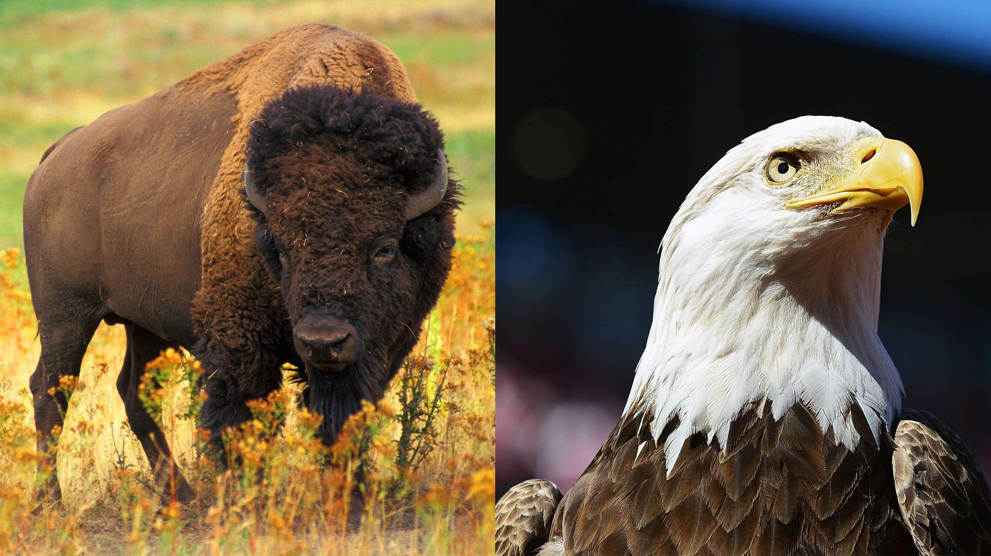
BuffaloFieldCampaign.Org
Notes:
The American Bison (or Buffalo) now joins the ranks of the Bald Eagle as an official symbol of our country.

Slide 11
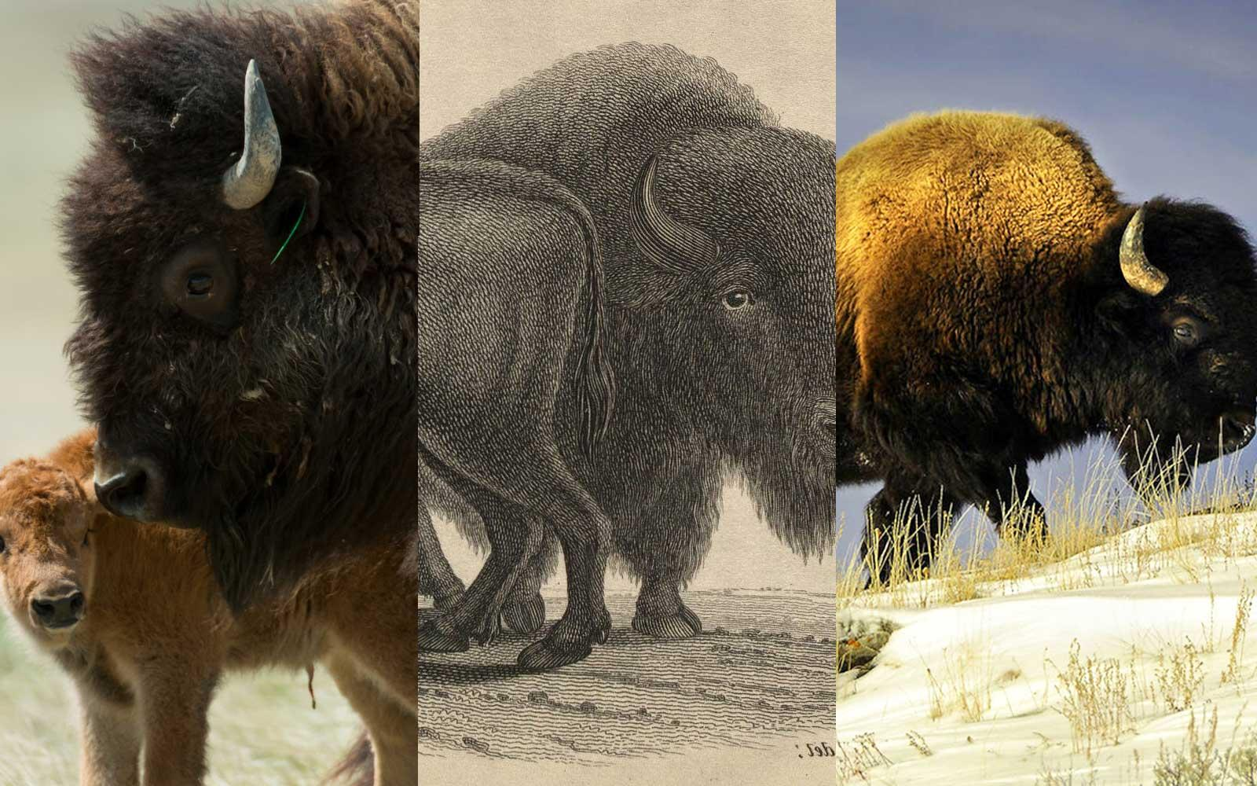
Natural
Heritage
Strength
of Spirit
Community
BuffaloFieldCampaign.Org
Notes:
Wild Buffalo embody Community, Natural Heritage, Strength of Spirit (Resiliency).
The American Bison is a keystone species; for plants and animals to survive and flourish, grassland ecosystems need free roaming buffalo on the land.

Slide 12
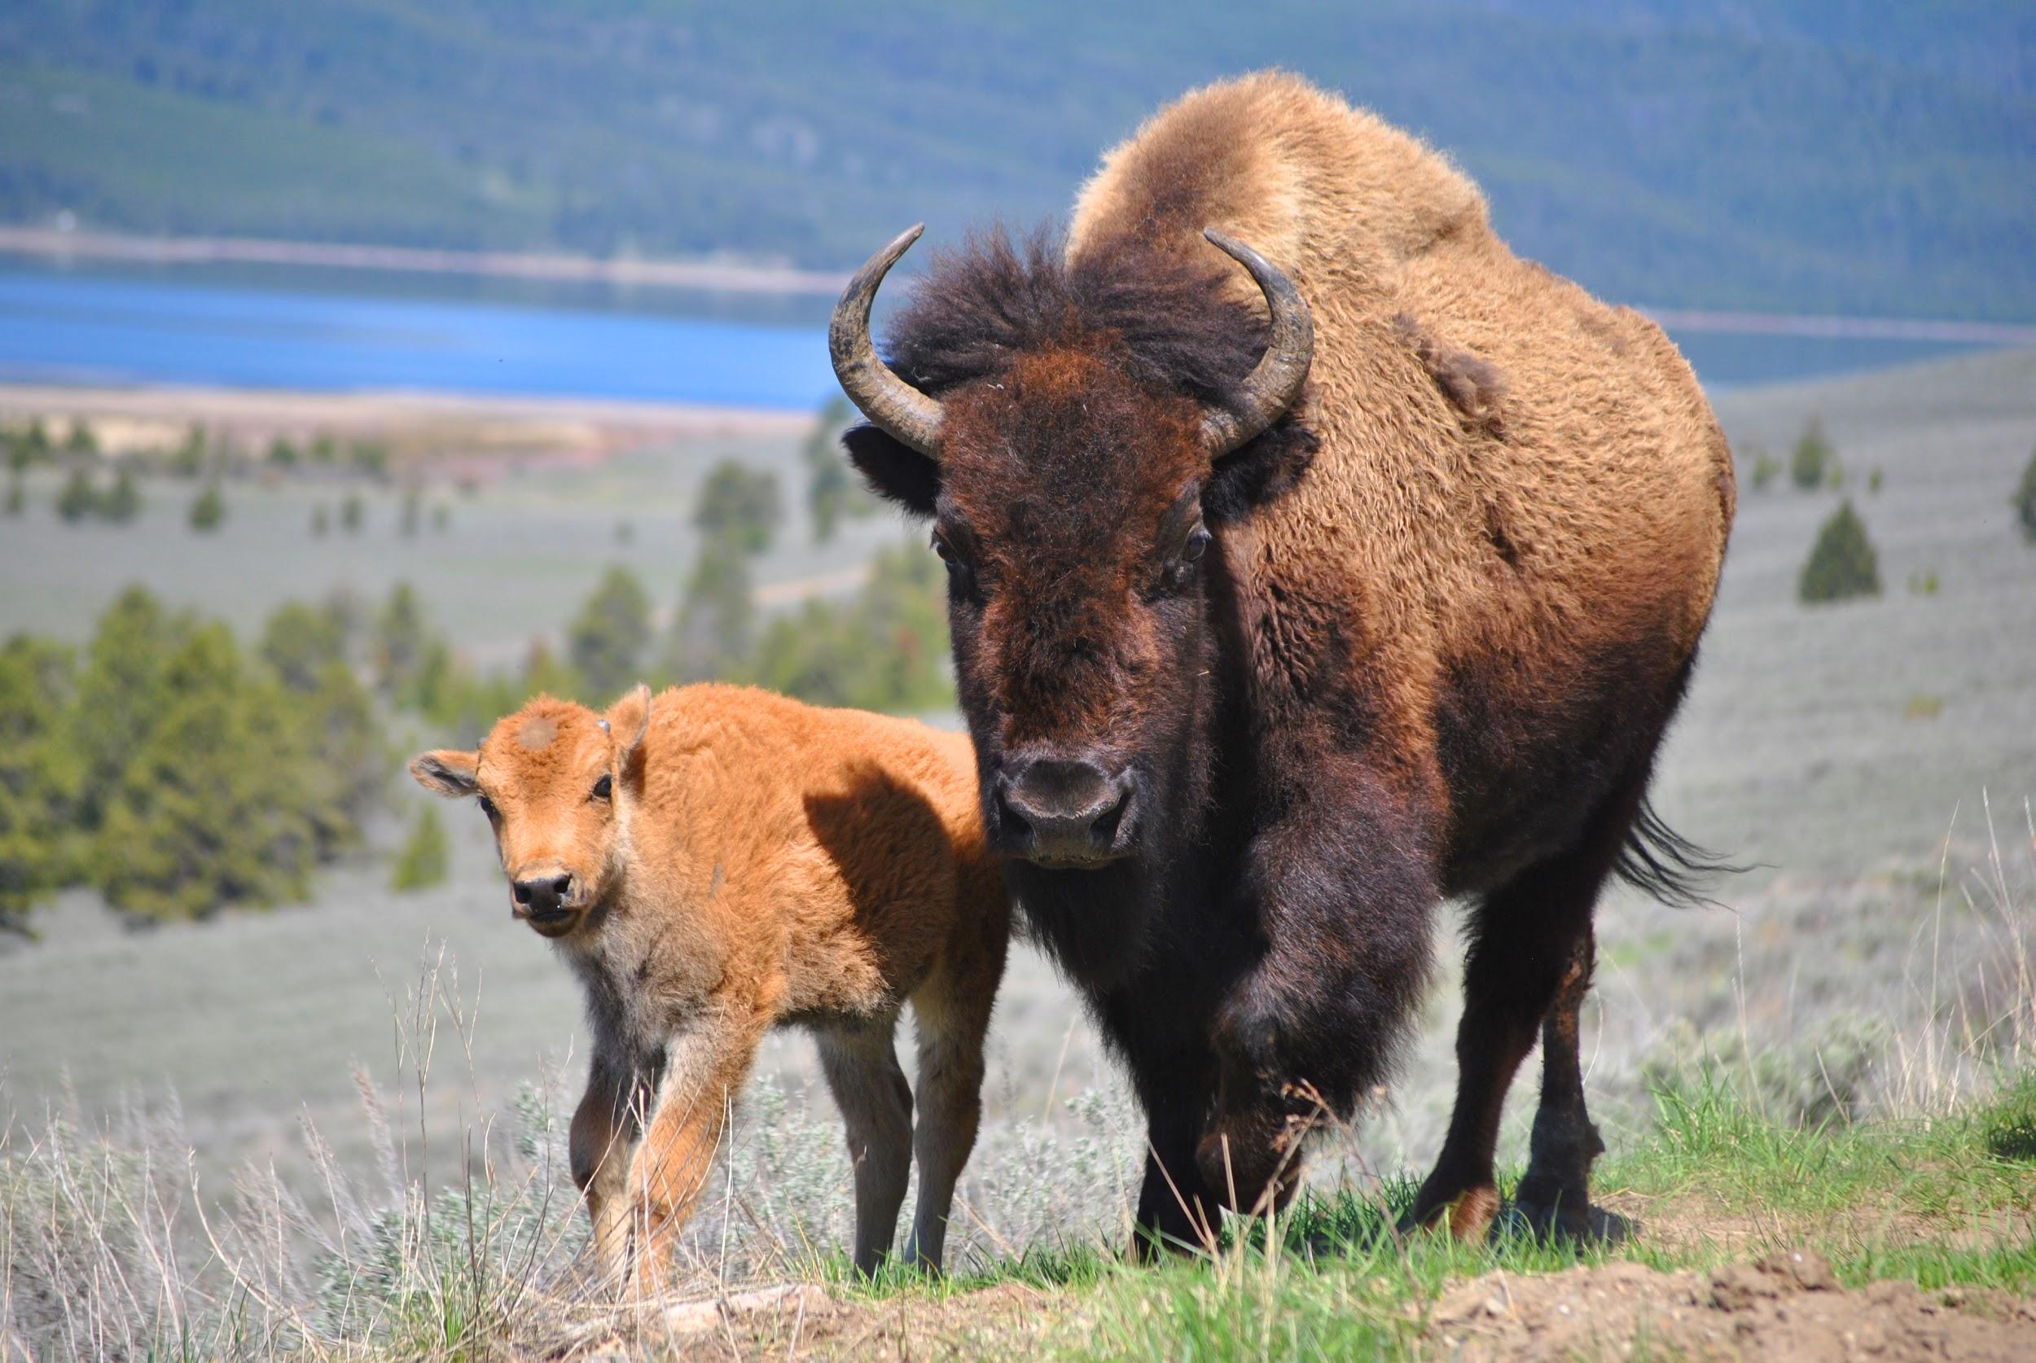
Community
North America’s Largest Mammal
BuffaloFieldCampaign.Org
Notes:
The majestic bison is the largest land mammal in North America. Male bison can weigh up to 2,000 pounds and stand 6 feet tall. A bison calf can weigh up to 70 pounds at birth.

Slide 13
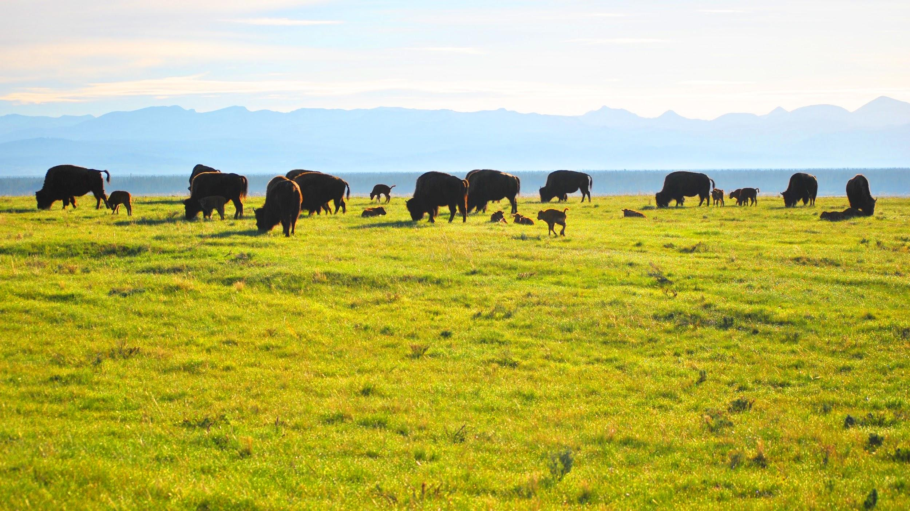
From Alaska to Mexico, Nevada to Appalachia
BuffaloFieldCampaign.Org
Notes:
In prehistoric times, millions of bison roamed North America:
From the forests of Alaska in the north to the grasslands of Mexico in the south.
From the Appalachian Mountains in the east to Nevada’s Great Basin in the west
Today, fewer than 3,600 wild bison exist within the Yellowstone ecosystem

Slide 14
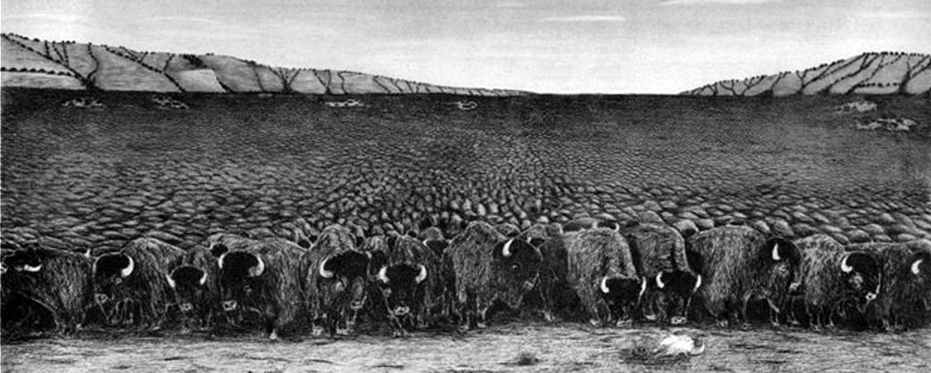
Natural Heritage
“The moving multitude…
darkened the whole plains”
—Lewis & Clark, 1806
BuffaloFieldCampaign.Org
Notes:
The sight of the bison herds was awe inspiring.
When Lewis and Clark encountered the bison at South Dakota’s White River, they wrote:
“The moving multitude…darkened the whole plains”

Slide 15
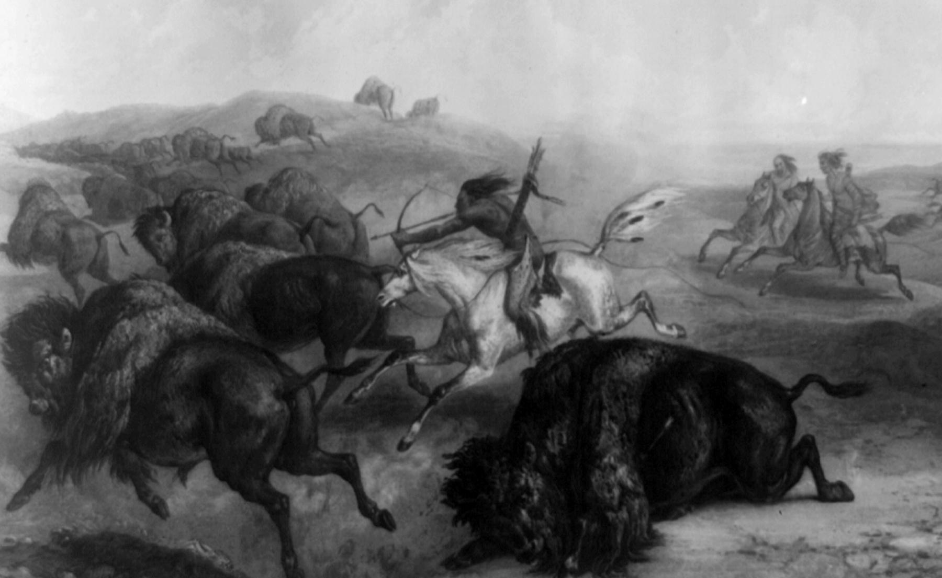
Natural Heritage
“The buffalo gave us everything we needed.
Without it we were nothing. ”
— John Fire Lame Deer,
Lakota Holy Man
BuffaloFieldCampaign.Org
Notes:
The life of the bison and Native People are intertwined. In the words of Lakota Holy Man, John Fire Lame Deer:
“The buffalo gave us everything we needed. Without it we were nothing. Our tipis were made of his skin. His hide was our bed, our blanket, our winter coat.
………..His flesh strengthened us, became flesh of our flesh.”

Slide 16
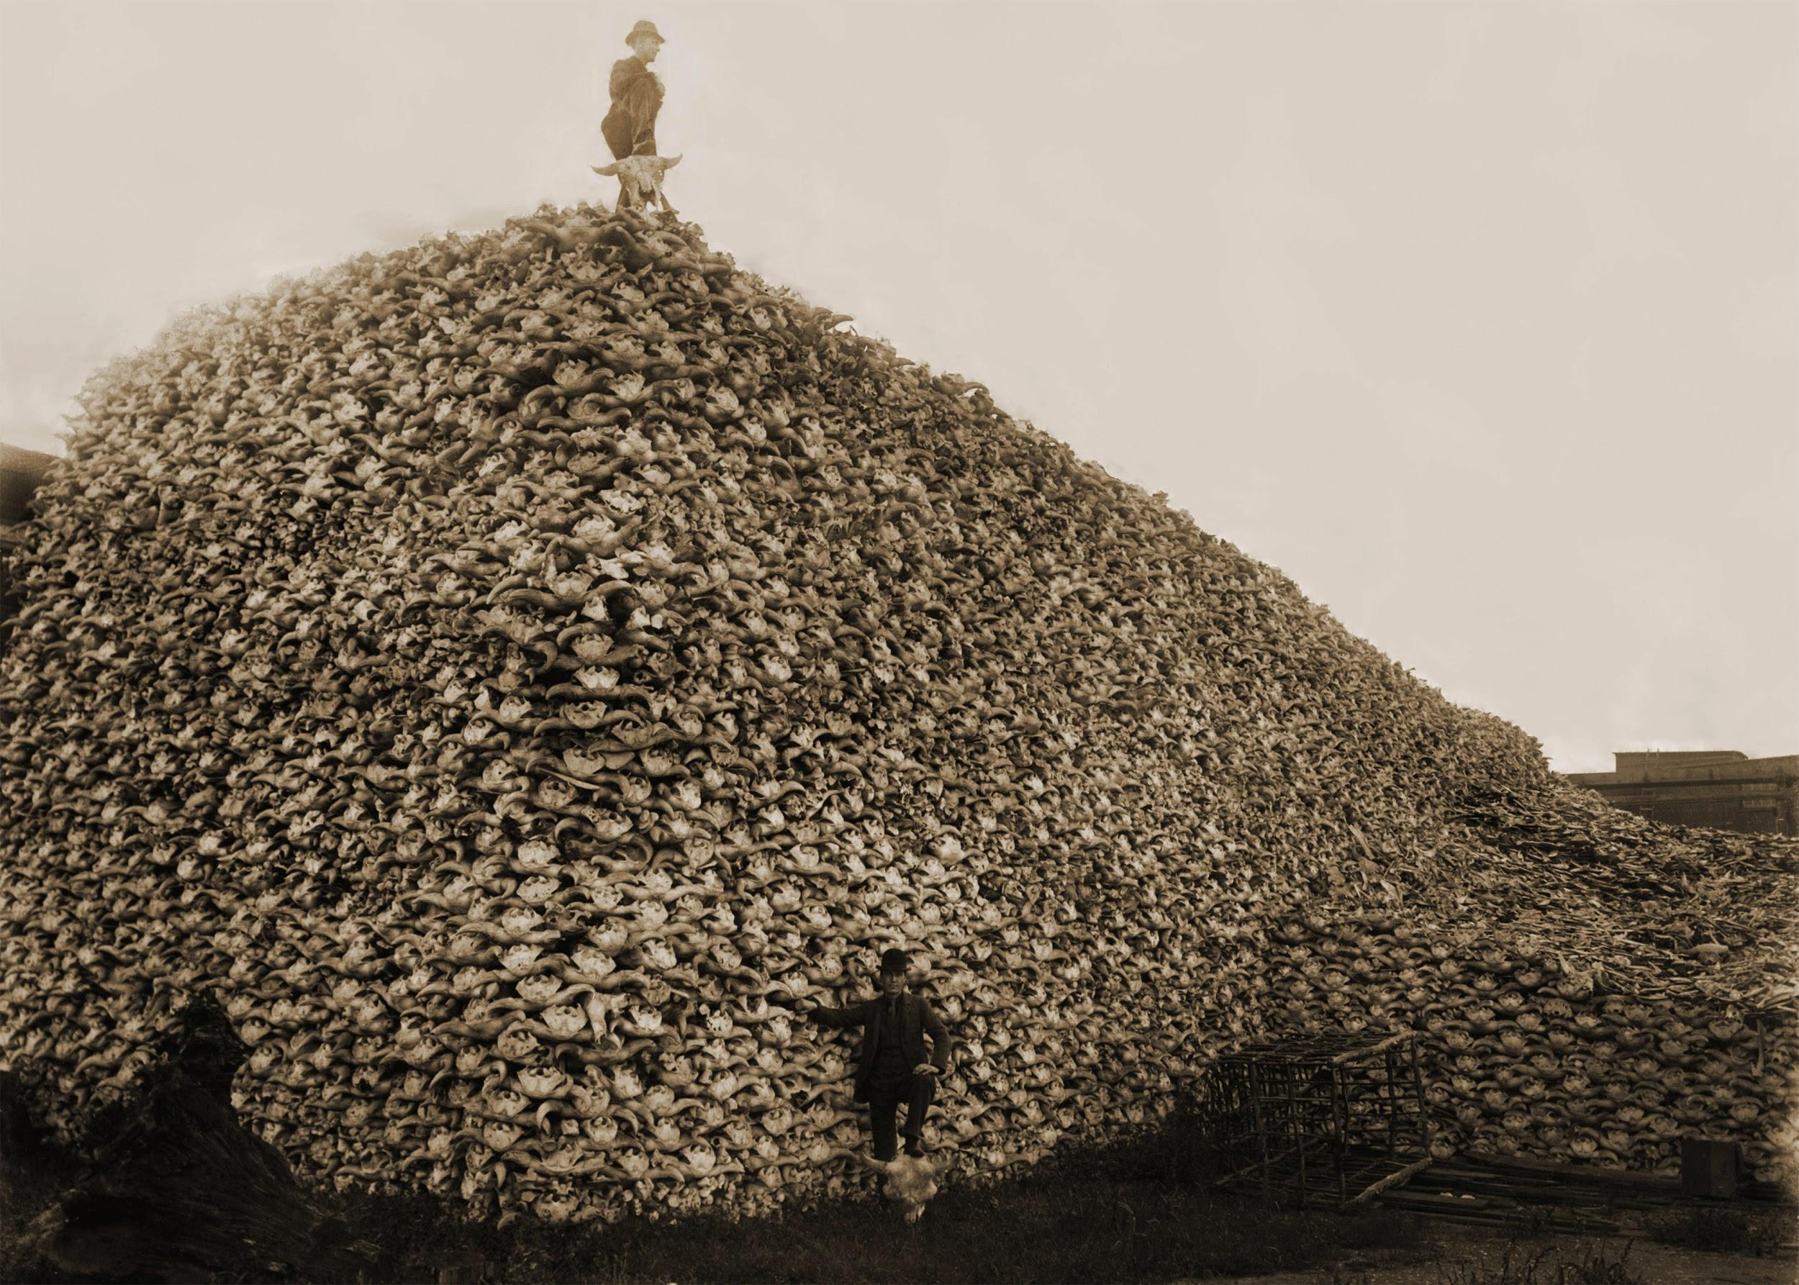
Natural Heritage
Man standing on skulls of bison ready to be ground into fertilizer
BuffaloFieldCampaign.Org
Notes:
Buffalo also remind us of a dark recklessness in the quest for land and profit.
The American Buffalo were hunted to near extinction.
Out of the millions of buffalo that once roamed North America, by the late 1800s only a few hundred remained in the United States.
For the US Military and industrialists, eliminating the buffalo also meant eliminating the staff of life for Native Americans, and taking the land that sustained them.
Photo: Man standing on skulls of bison ready to be ground into fertilizer

Slide 17
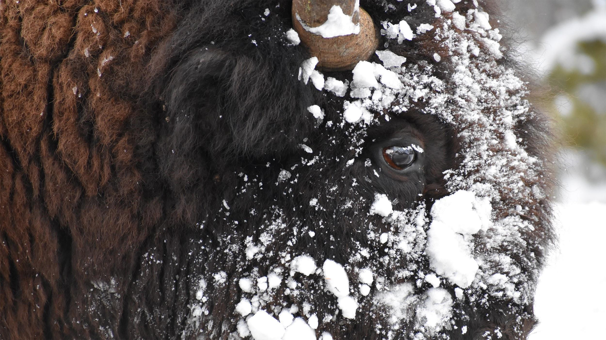
Resilience
BuffaloFieldCampaign.Org
Notes:
Despite being driven to near extinction, 23 individual wild buffalo survived in Pelican Valley (Yellowstone National Park)
...a testament to their strength of spirit and resilience.
BUT the work is not over.

Slide 18
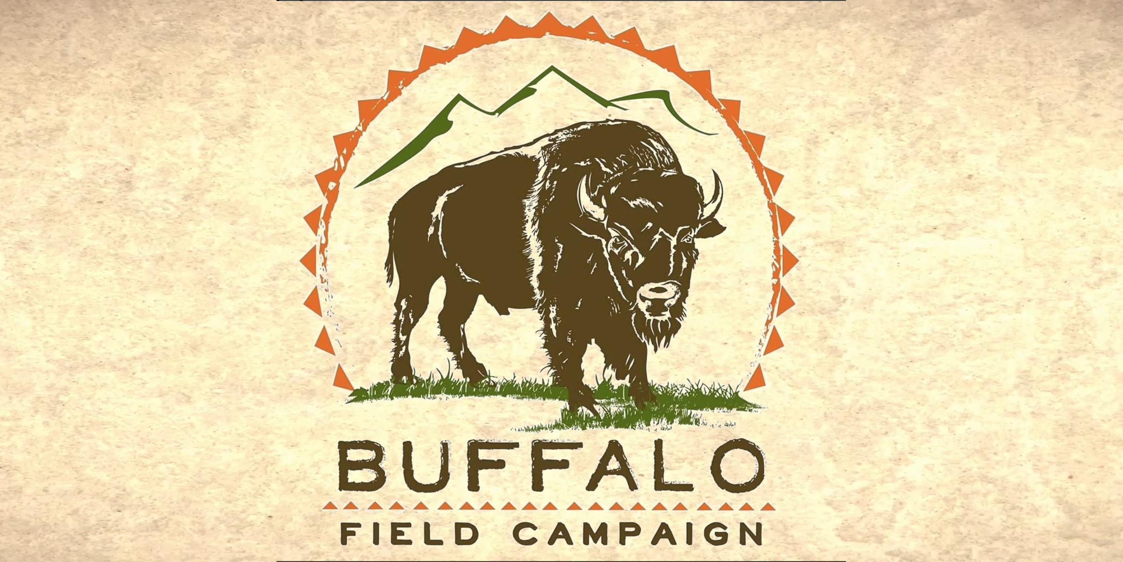
BuffaloFieldCampaign.Org
Notes:
In 1997, Buffalo Field Campaign was established by Lakota elder Rosalie Little Thunder and Mike Mease to establish a permanent buffalo defense for the Yellowstone herds.

Slide 19
Strength of Spirit
The Last Wild Herds
BuffaloFieldCampaign.Org
Notes:
What makes the Yellowstone herds special?
In the United States, the Yellowstone herds are the last continuously wild, migratory buffalo populations that remain intact.
The Yellowstone bison are the last descendants of the early bison that roamed our country’s grasslands.

Slide 20
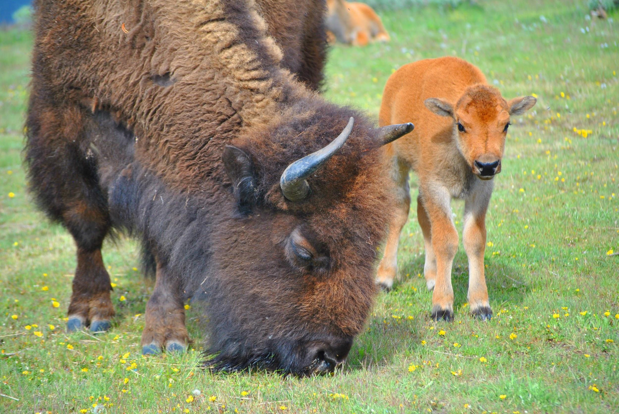
Strength of Spirit
BuffaloFieldCampaign.Org
Notes:
The Yellowstone ecosystem is the only place in the U.S. where bison have continuously lived since prehistoric times.
Currently, Yellowstone’s bison population numbers fewer than 3,600 — making them vulnerable to extinction.

Slide 21
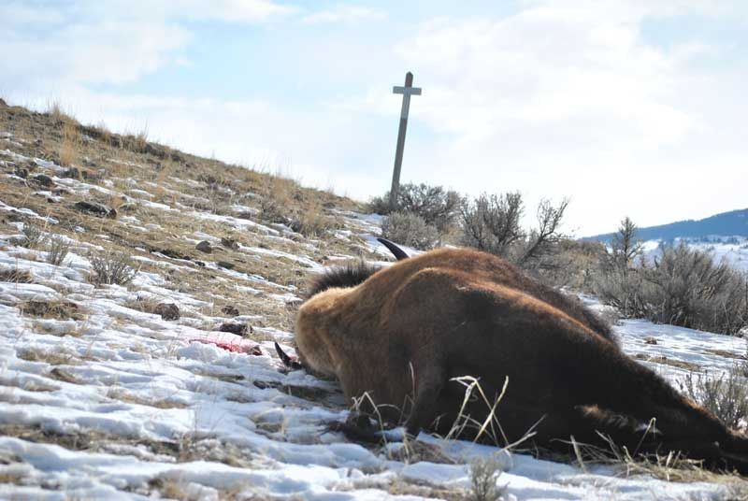
Threats
BuffaloFieldCampaign.Org
Notes:
The last wild herds of the Yellowstone ecosystem face many threats.

Slide 22
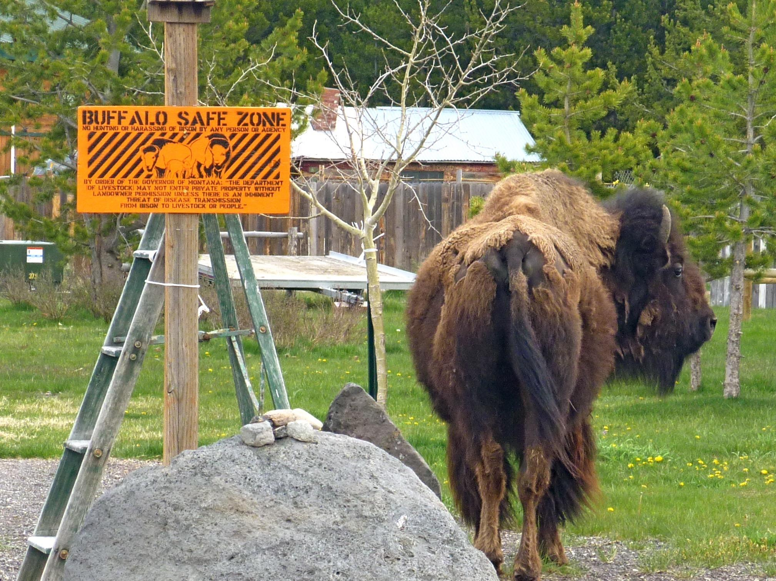
Natural Habitat Protection
BuffaloFieldCampaign.Org
Notes:
In 2016, thanks to endless pressure, endlessly applied by Buffalo Field Campaign, over 200,000 acres of public land on the Horse Butte Peninsula were protected as year around wild bison habitat.

Slide 23
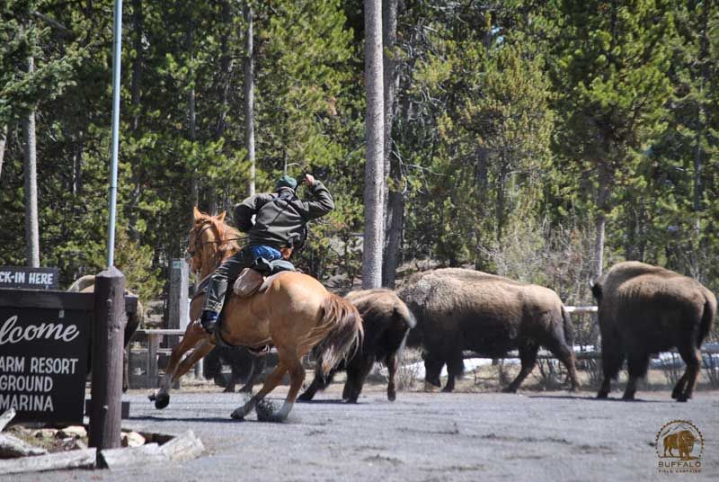
BuffaloFieldCampaign.Org
Notes:
Buffalo Field Campaign also works to protect the wild Yellowstone buffalo and their calves from harassment on National Forest lands by the Montana Department of Livestock and other government agents.

Slide 24
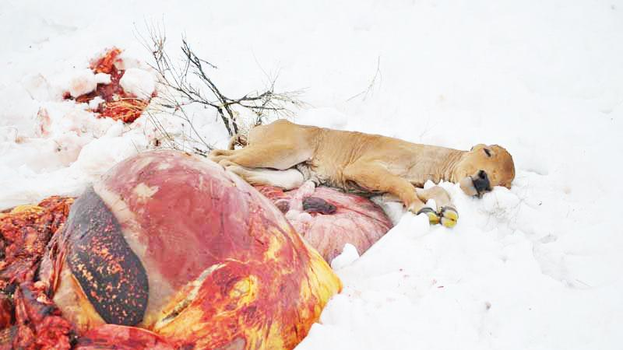
BuffaloFieldCampaign.Org
Notes:
The Yellowstone buffalo are also victims to hunting and slaughter.

Slide 25
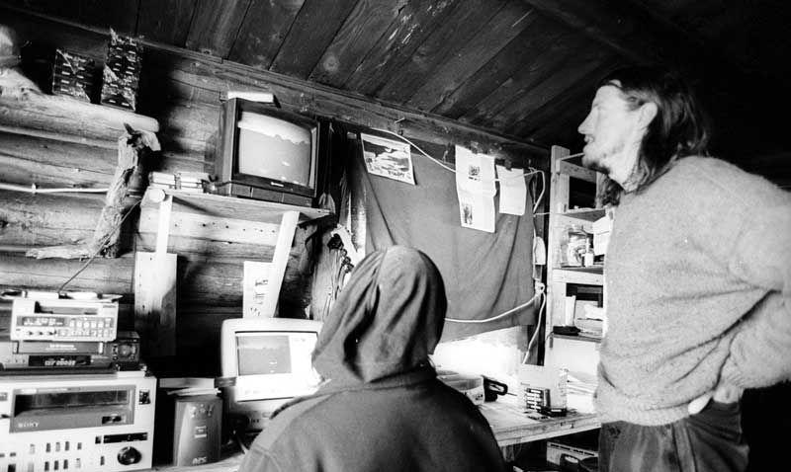
BuffaloFieldCampaign.Org
Notes:
In 1995, controversial legislation (MCA 81-2-120) was put into place transferring authority over bison management from the Montana Department of Fish, Wildlife and Parks to the Montana Department of Livestock (DOL).

Slide 26
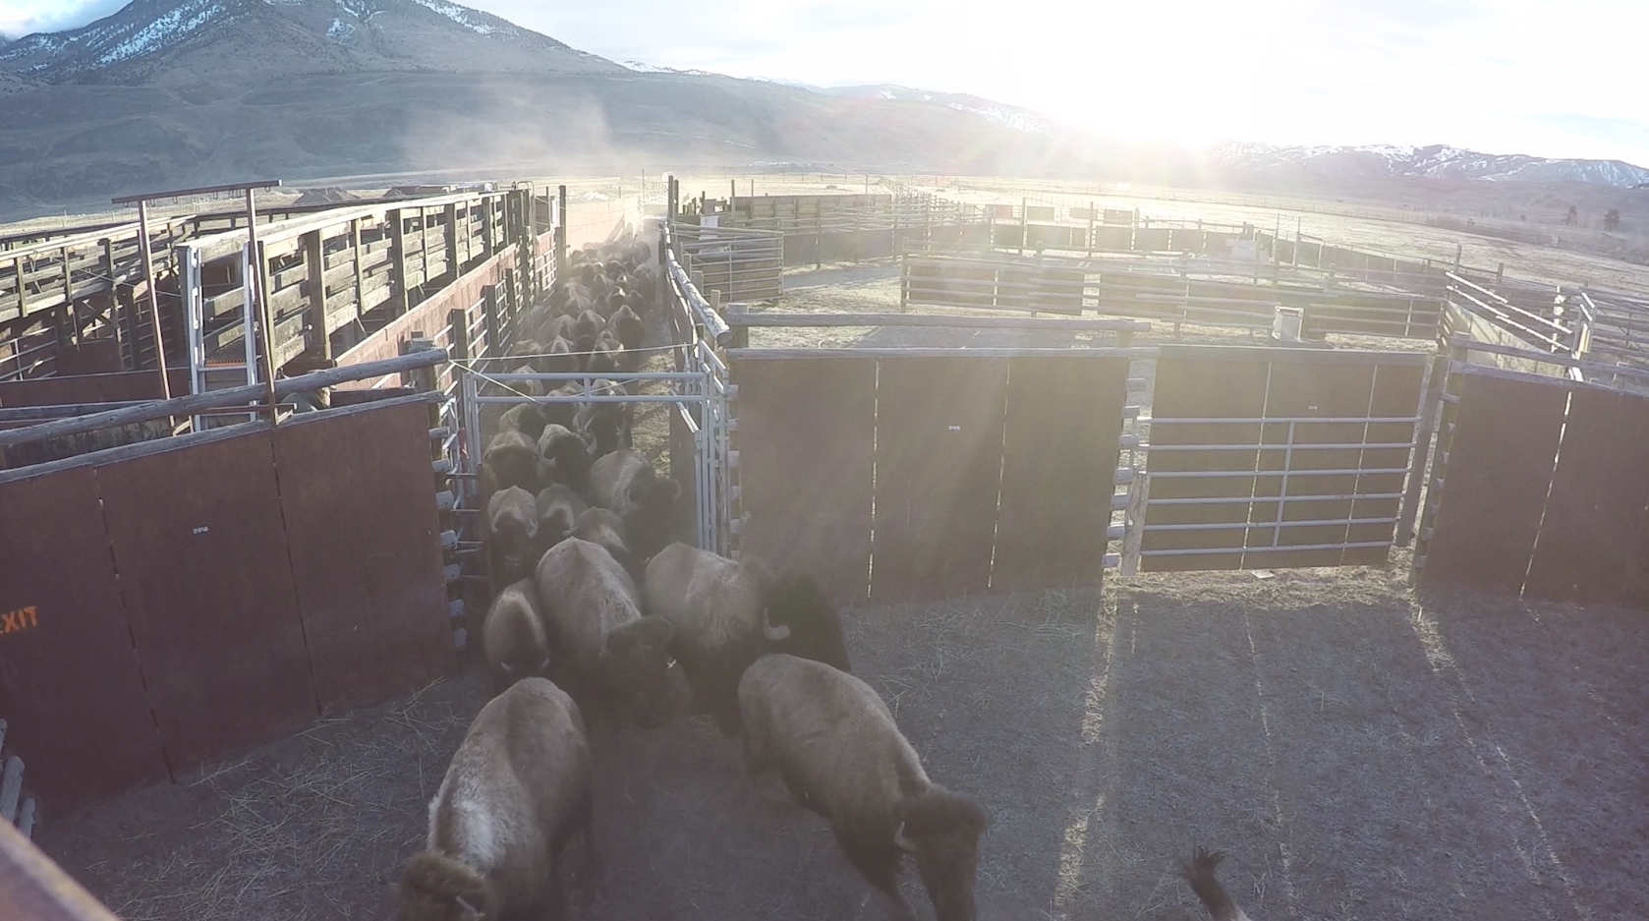
Still image from short film "Our National Mammal"
BuffaloFieldCampaign.Org
Notes:
On behalf of the DOL, more than 6000 bison have been slaughtered, more than the entire population of wild buffalo alive in the Yellowstone ecosystem today.

Slide 27
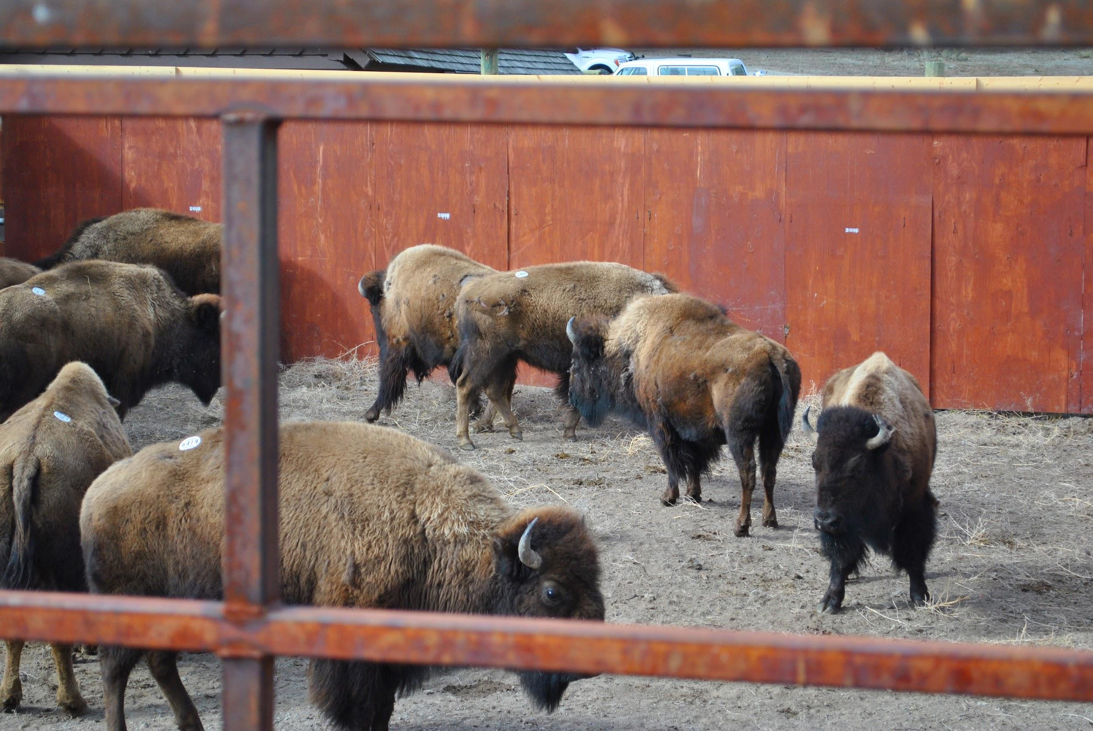
BuffaloFieldCampaign.Org

Slide 28
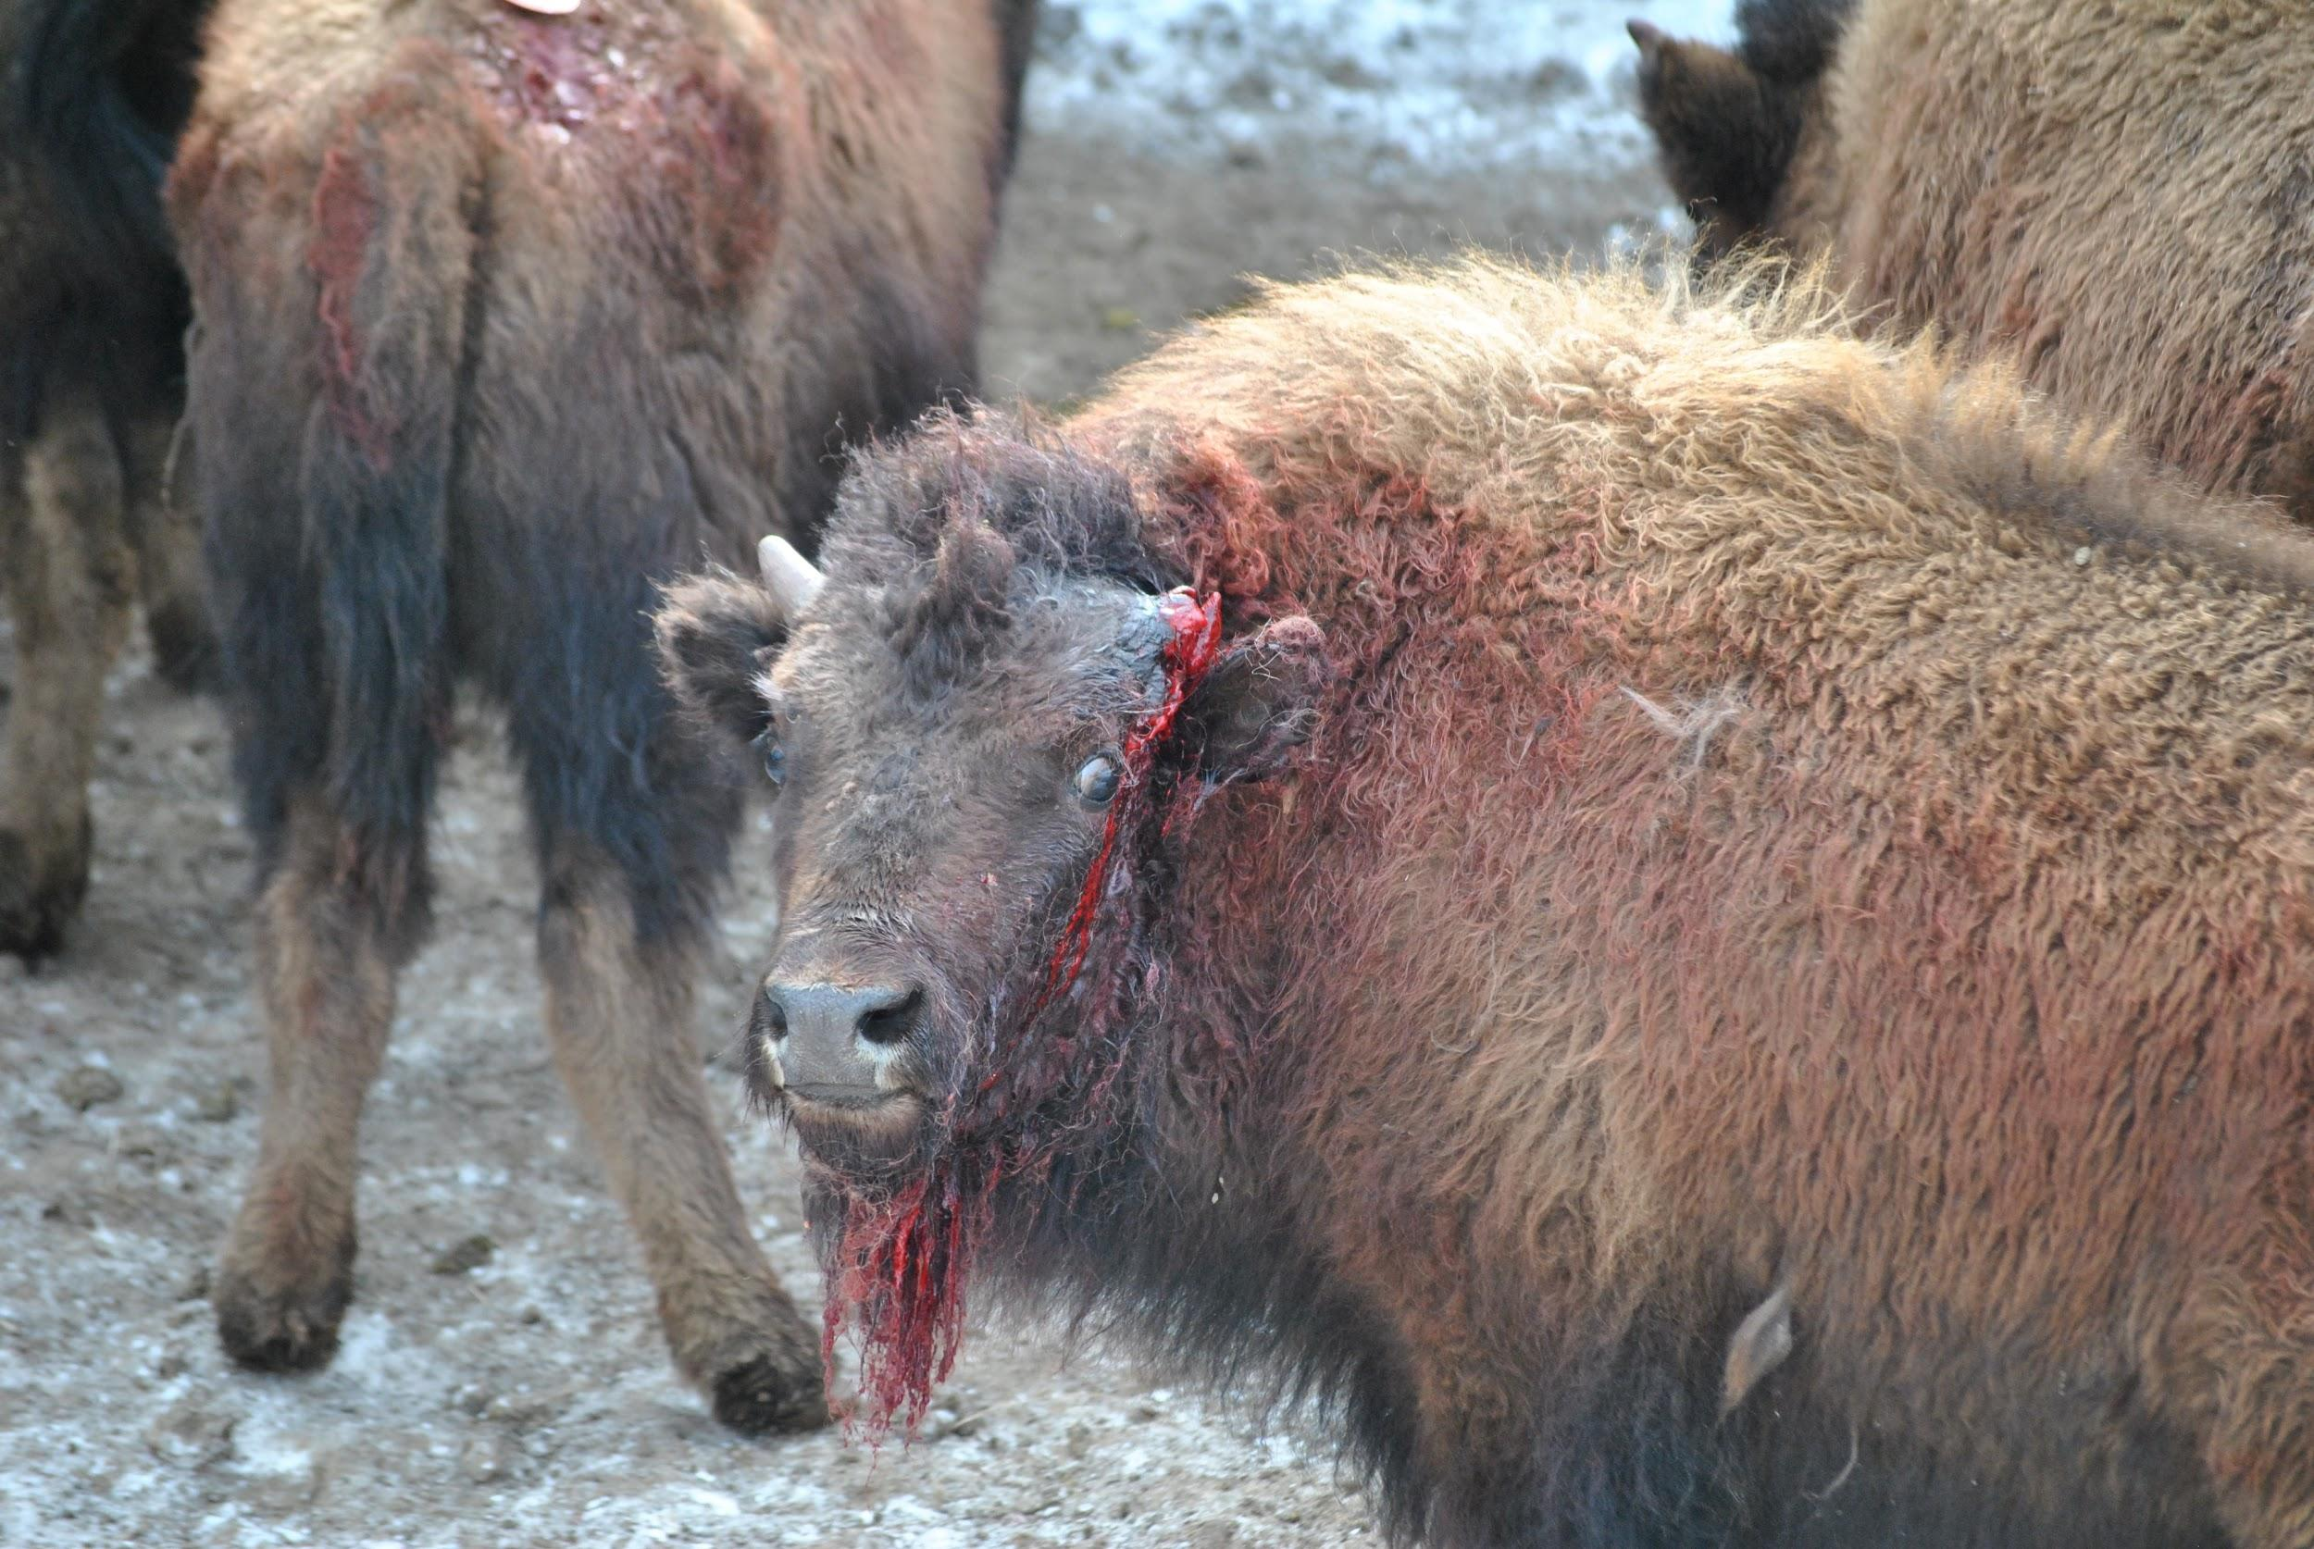
BuffaloFieldCampaign.Org

Slide 29
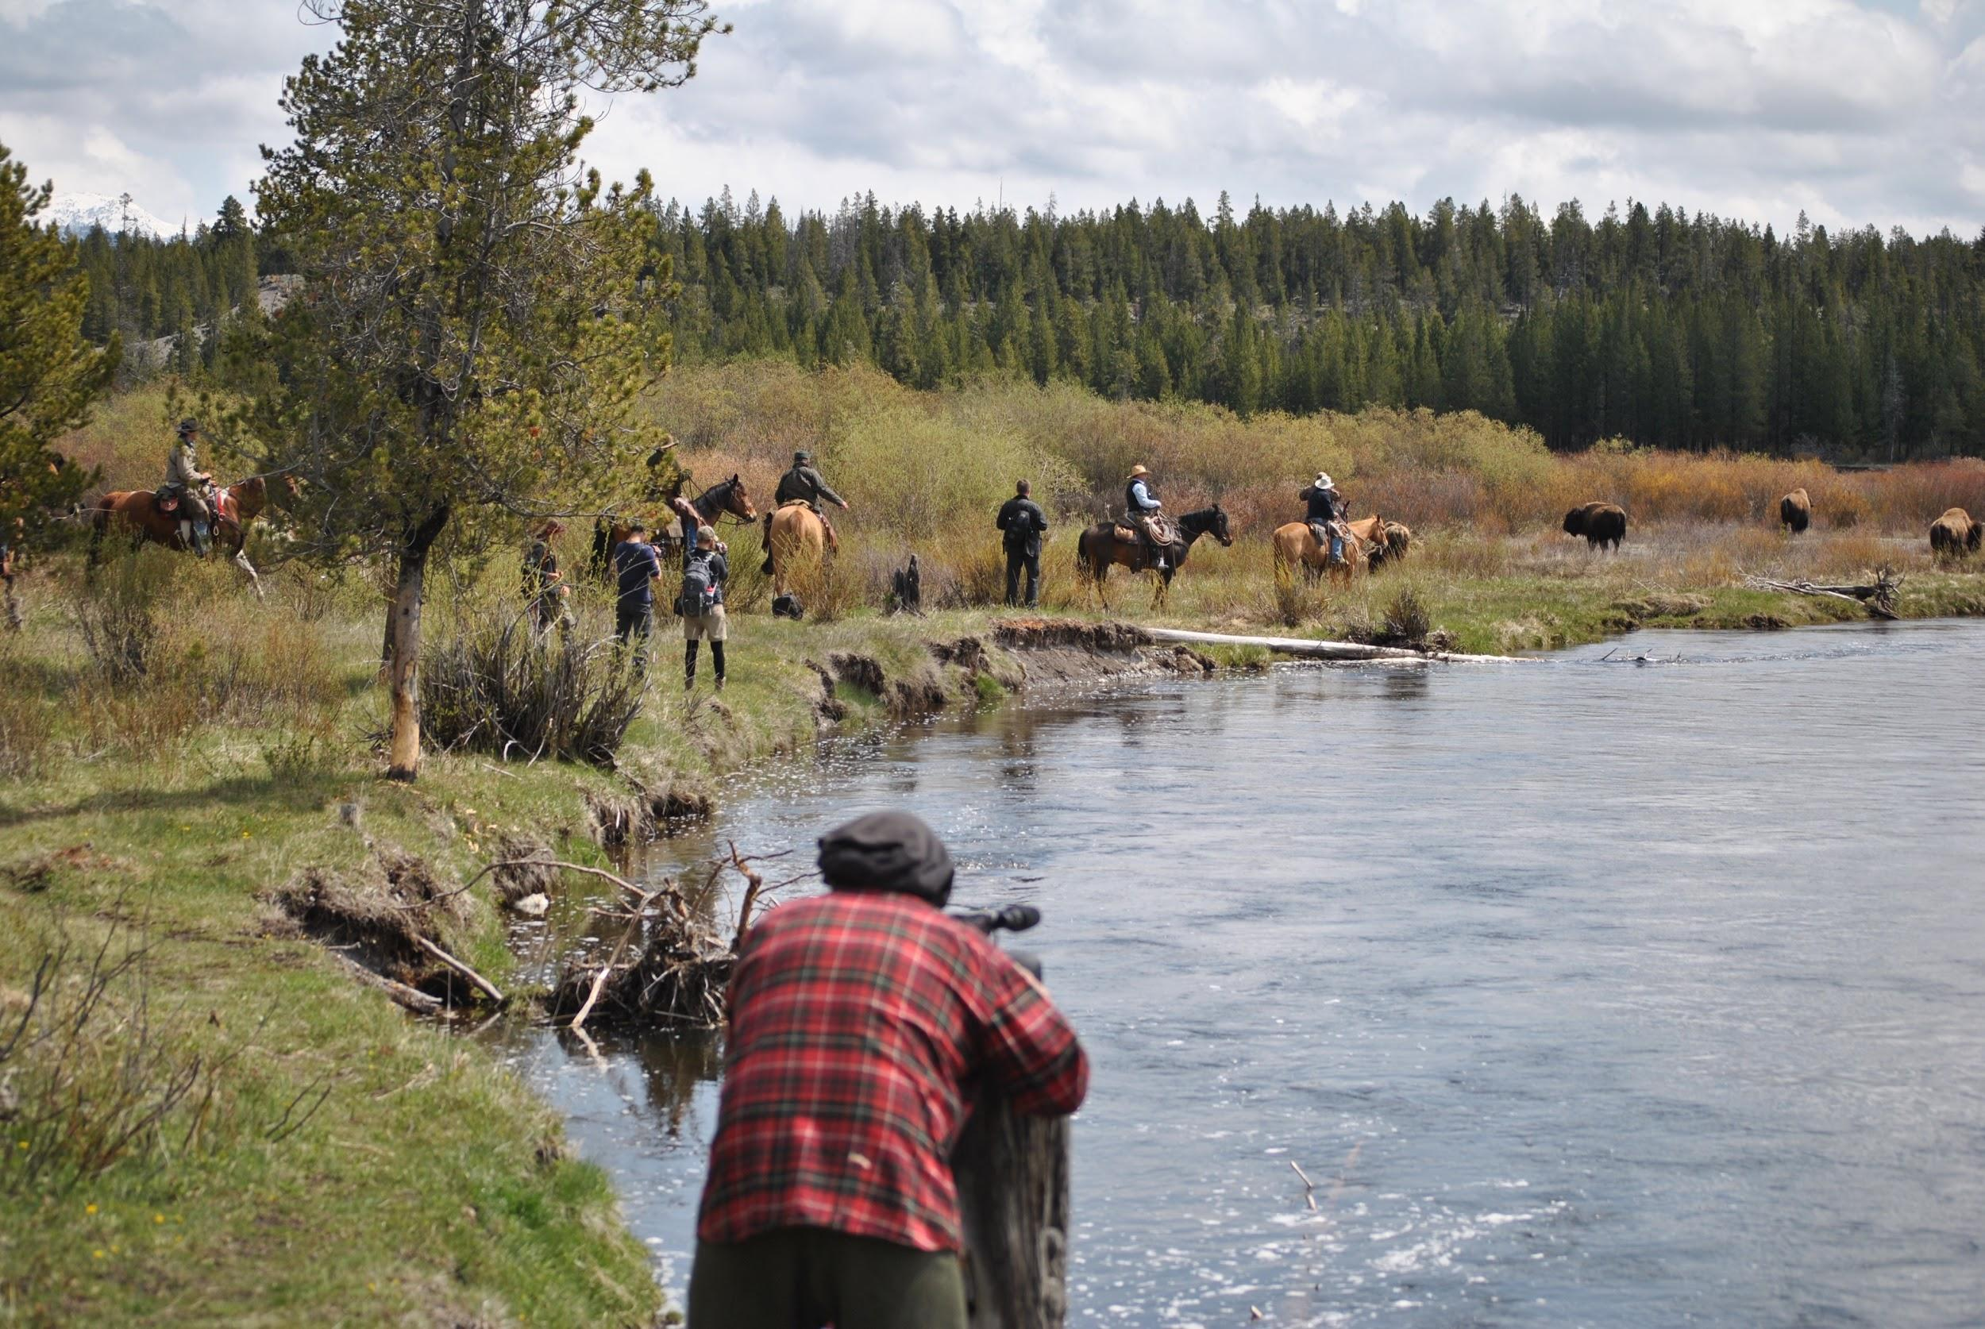
BuffaloFieldCampaign.Org
Notes:
The work of BFC in the field is crucial. BFC monitors buffalo migration, changes in their health and safety as well as the activities of Yellowstone National Park, the DOL, and all complicit agencies.
BFC monitors the hunt and also educates and activates our members, supporters, and the public to the plight of the Yellowstone herds.

Slide 30
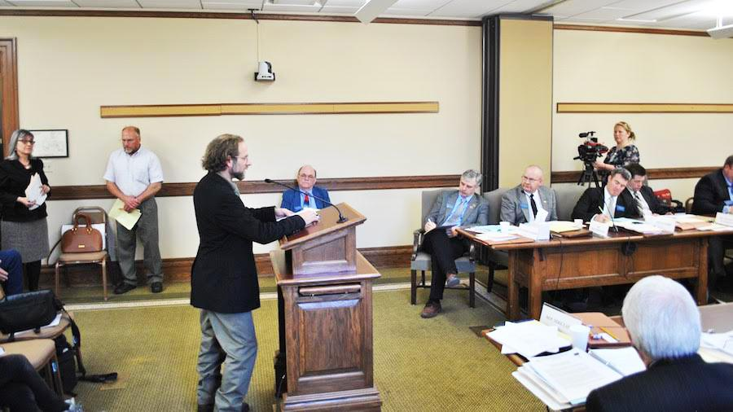
BuffaloFieldCampaign.Org
Notes:
Buffalo Field Campaign is the only group working in the field, in the courts, and policy arenas to protect America’s last wild buffalo and their habitat.

Slide 31
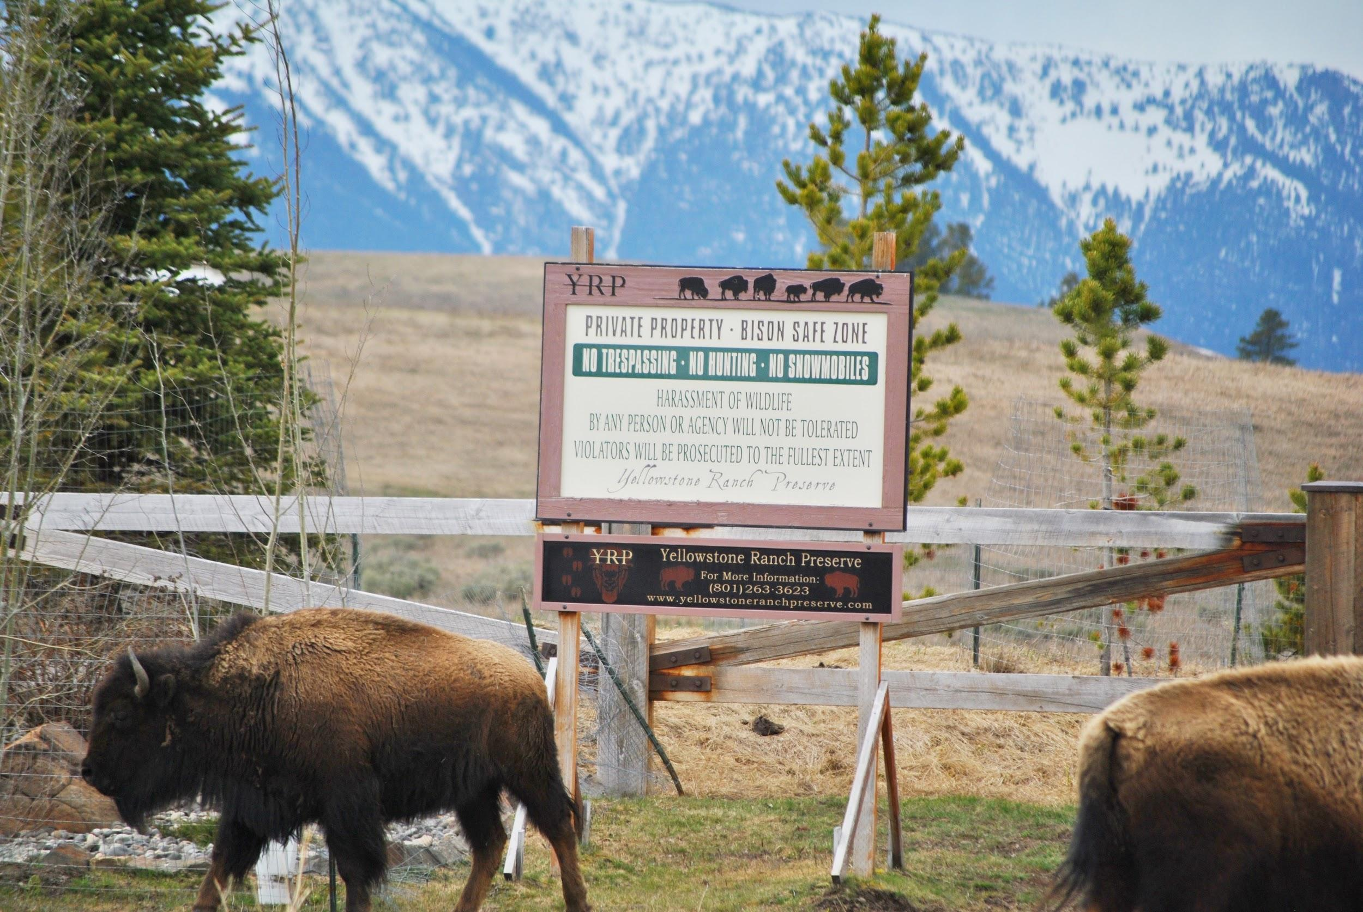
BuffaloFieldCampaign.Org
Notes:
Our primary goal is to create permanent, year-round protection for the Yellowstone herds and the ecosystem they depend on.

Slide 32
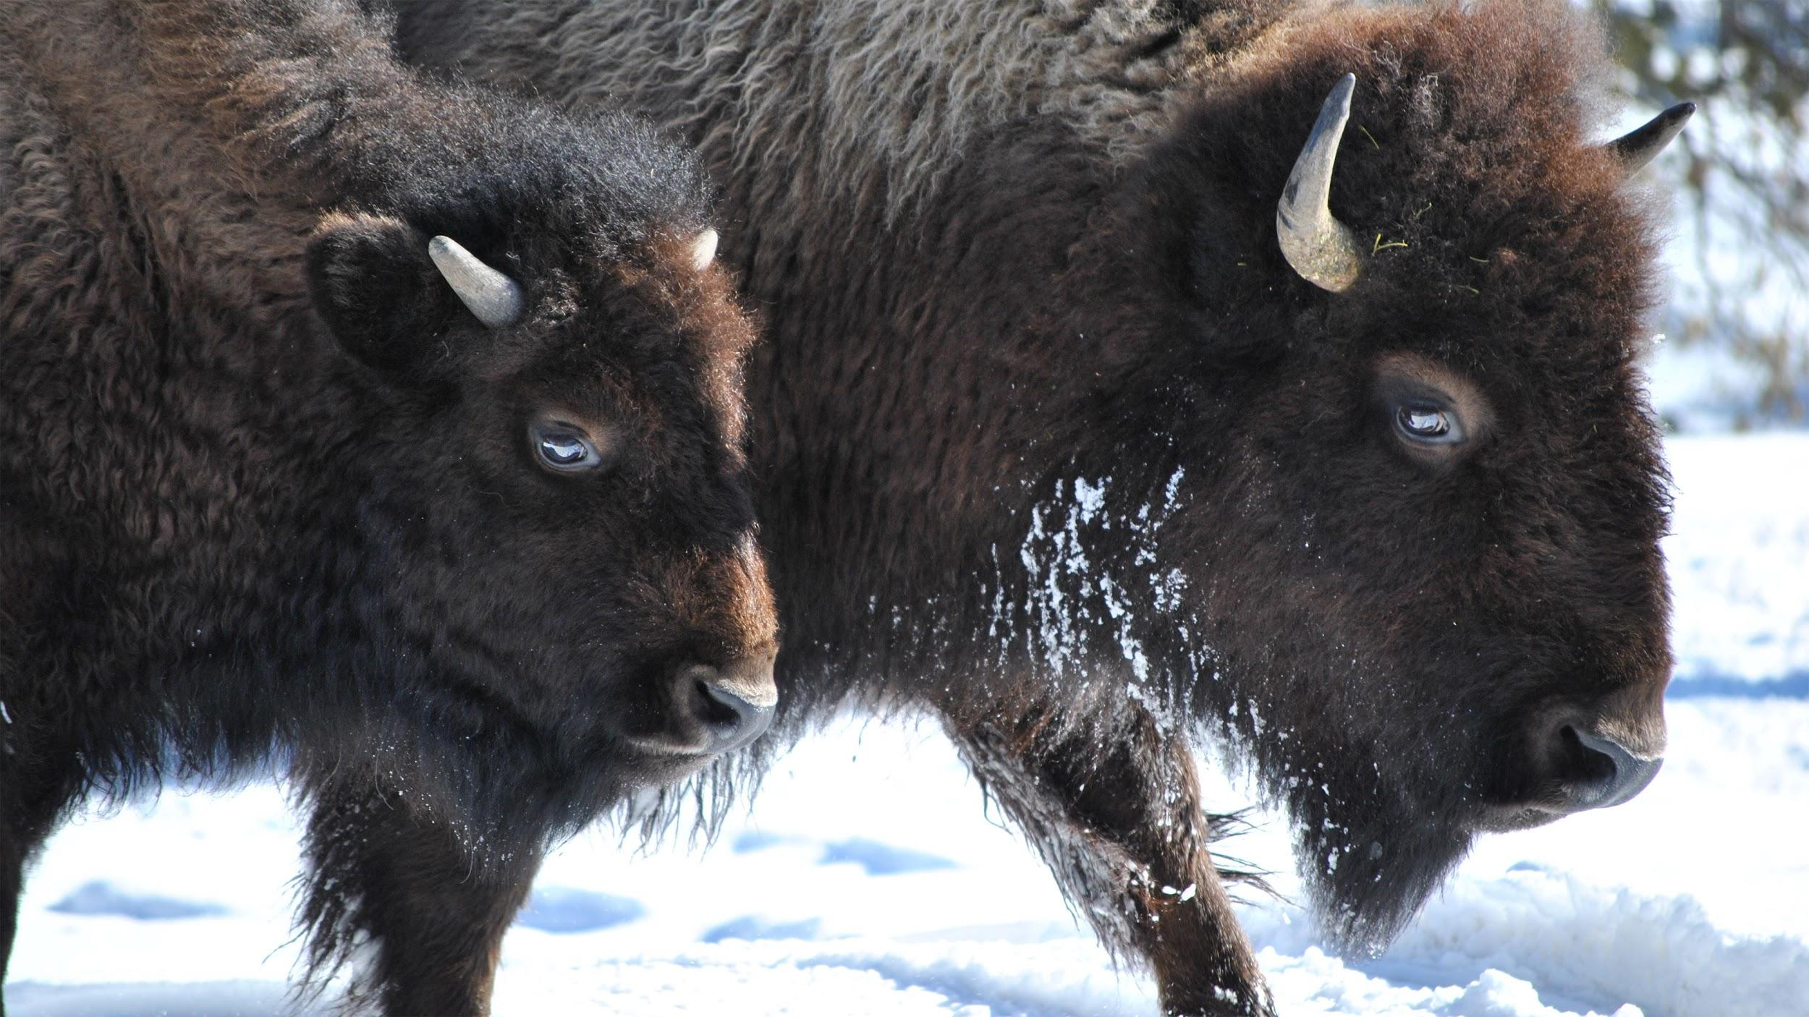
Become an Ally
BuffaloFieldCampaign.Org
Notes:
But we need your help.
Become an ally. Help Buffalo Field Campaign protect America’s National Mammal. Help us protect the last wild descendants of the original bison that roam our country’s grasslands.

Slide 33
How can you help?
BuffaloFieldCampaign.Org
Notes:
How can you help?

Slide 34
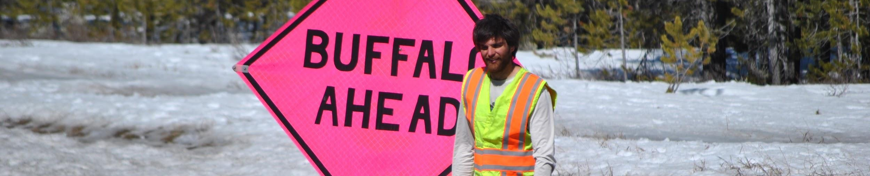
Help Recover Wild Migratory Bison
Help us protect the American Bison as an Endangered Species
America is blessed with an abundance of public trust lands: National Parks, National Forests, National Wildlife Refuges, and Bureau of Land Management holdings
Public trust lands can and should provide habitat for wild bison recovery
BuffaloFieldCampaign.Org
Notes:
Help us protect the American Bison as an Endangered Species
America is blessed with an abundance of public trust lands: National Parks, National Forests, National Wildlife Refuges, and Bureau of Land Management holdings
Public trust lands can and should provide habitat for wild bison recovery.
Buffalo Field Campaign has won the first round in the long and arduous process of Endangered Species Act listing. By becoming a supporting member of BFC you can help to fund, educate and support our efforts to ensure that this country’s only wild, migratory buffalo are protected and have the freedom to roam!

Slide 35
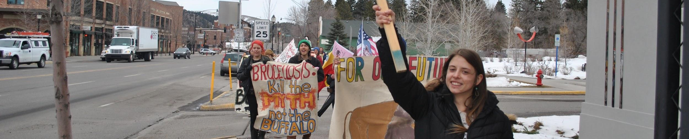
Help us Raise Public Awareness of
Our National Mammal
The National Bison Legacy Act does not include protective measures for wild bison
Most people are unaware of the National Bison Legacy Act and its’ designation,
help to spread the word!
Contact your members of Congress to demand protections for Our National Mammal
BuffaloFieldCampaign.Org
Notes:
Help us Raise Public Awareness of Our National Mammal
The National Bison Legacy Act does not include protective measures for wild bison
Sec. 3(b) Rule of Construction states:
Nothing in this Act . . . shall be construed or used as a reason to alter, change, modify, or otherwise affect any plan, policy, management decision, regulation, or other action by the Federal Government.
Buffalo Field Campaign has been working to educate the public and legislators on the failure of the National Bison Legacy Act and its failure to include the same protective measures for the American Bison that are granted to the Bald Eagle.
CALL TO ACTION:
You can help by contacting your members of congress do demand protections for our National Mammal!
Find helpful links on our site to help you get you in touch with your representatives:
http://www.buffalofieldcampaign.org/get-involved

Slide 36
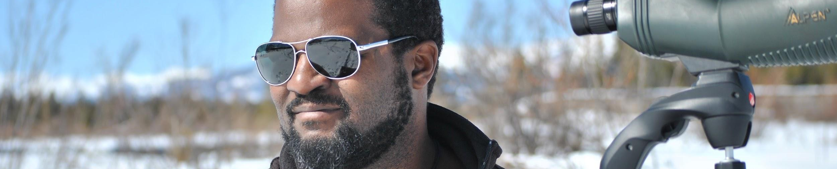
Become an Advocate
Help us educate the public on the plight of our National Mammal
Give this presentation to your class, coworkers, community group or any group
who may be interested
Ask me for more information on how to download this presentation
BuffaloFieldCampaign.Org
Notes:
Become an Advocate
Help us educate the public on the plight of our National Mammal. Give this presentation to your class, coworkers, community group or any group who may be interested.
CALL TO ACTION:
See me after this presentation for more information

Slide 37
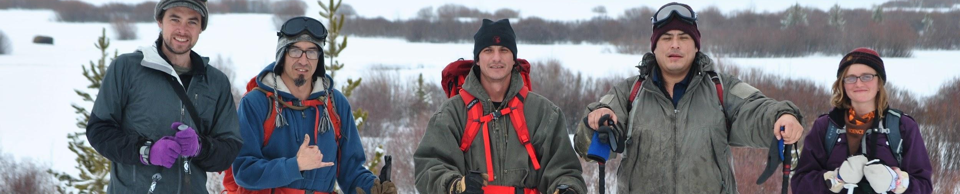
Visit BuffaloFieldCampaign.org and get involved
Join us in the Field
Sign up for our Updates from the Field
Become a Buffalo Guardian
BuffaloFieldCampaign.Org
Notes:
Some other ways to be our ally:
• Join Us in the Field!
Come to West Yellowstone and volunteer with BFC and with the buffalo! All volunteers receive room, board, training and the honoring of standing with Our Sacred Buffalo.
• Sign up for our Updates from the Field!
Continue to educate yourself about the buffalo with these weekly updates that include photos, field journals, and calls to action.
• Pledge to donate monthly to support our work and the buffalo and become a Buffalo Guardian.
Your support ensures that Buffalo Field Campaign volunteers stay warm, well fed, and ready to do their work in the field with the buffalo.
Your support ensures that Buffalo Field Campaign’s work in the courts and policy arena is sustained, growing, and strong.
CALL TO ACTION:
You can find all the links on buffalofieldcampaign.org or please come see me after the presentation

Slide 38
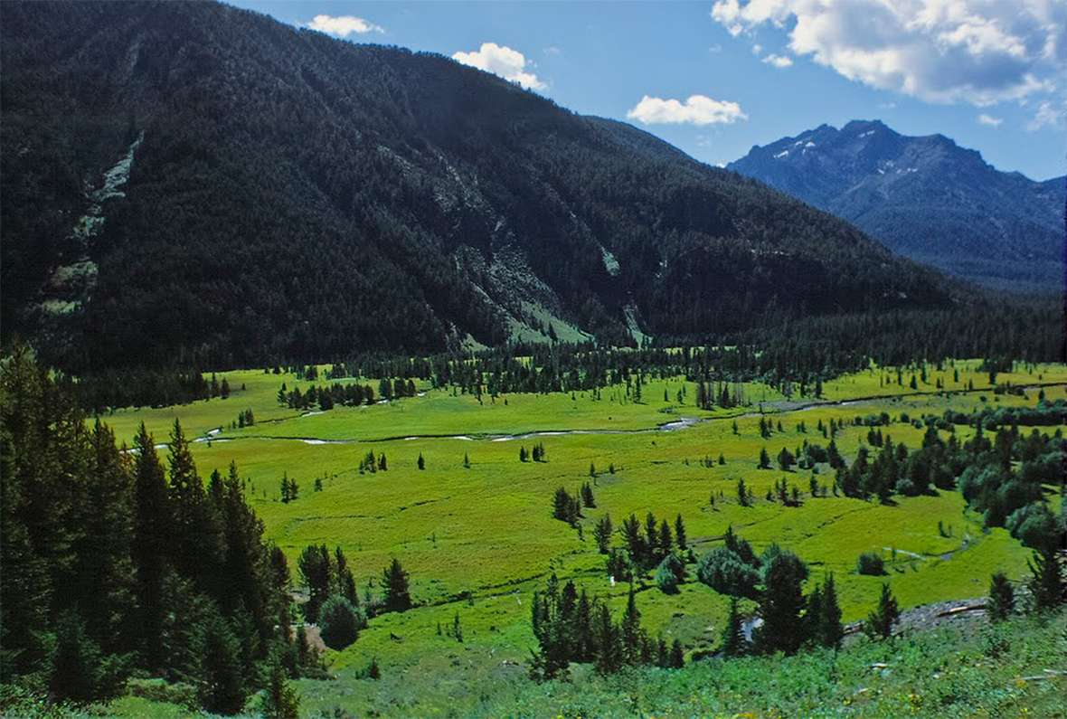
Spread the word on Social Media
BuffaloFieldCampaign.Org
Notes:
Please follow us on Facebook and Instagram. Share our updates and news releases.

Slide 39
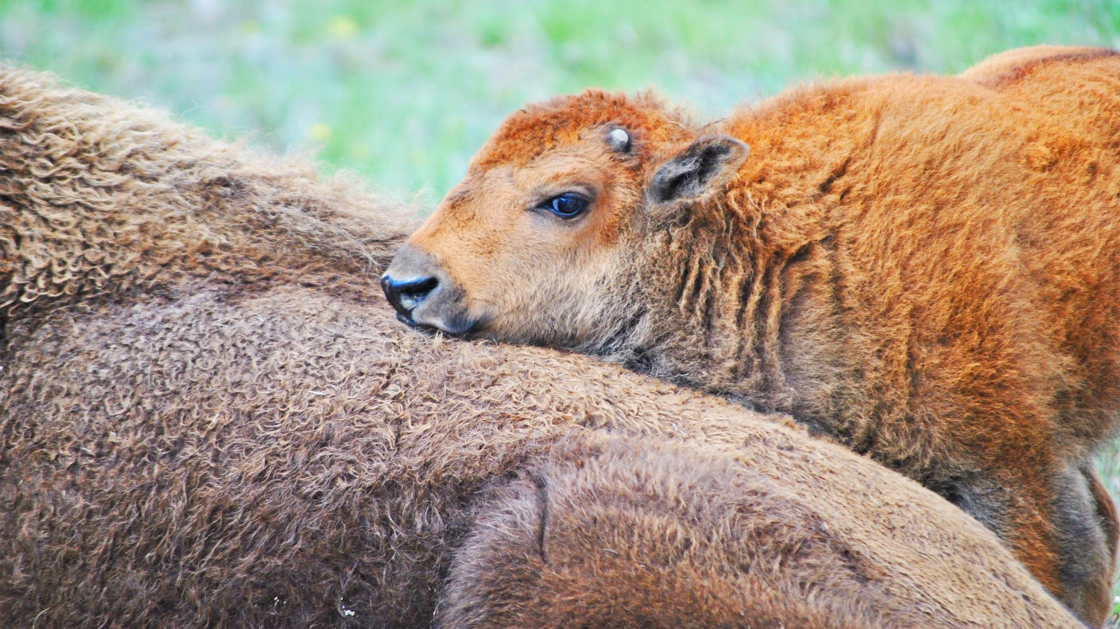
Financial Support
BuffaloFieldCampaign.Org
Notes:
Buffalo Field Campaign is a formalized 501(c)(3) nonprofit organization. We are always thankful and appreciative for any financial support you can offer us.

Slide 40
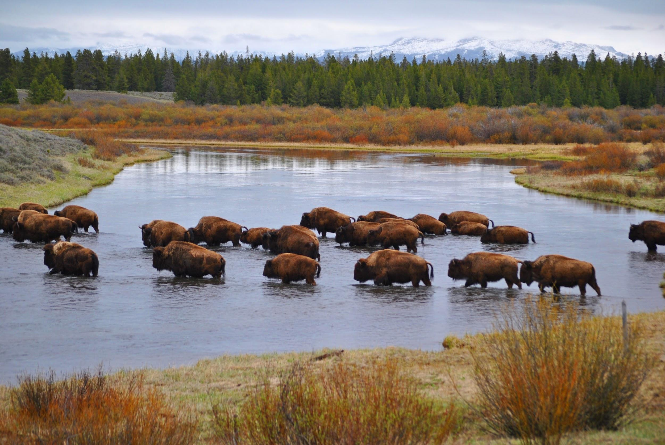
BuffaloFieldCampaign.Org
Notes:
We are fortunate to live in this beautiful country. Our National Mammal is the spiritual symbol of our natural heritage, strong family and community bonds, resilience, and freedom to roam.

Slide 41
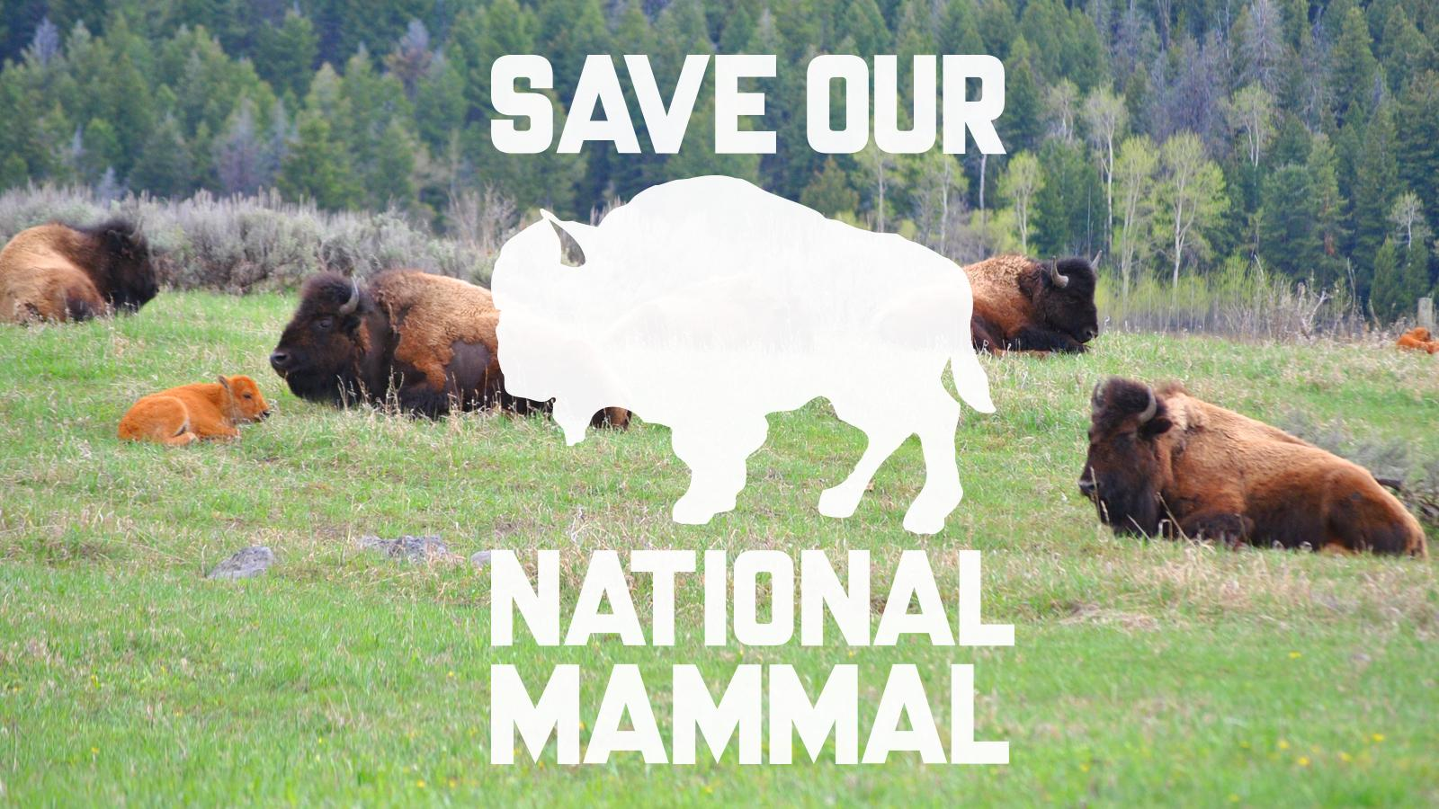
BuffaloFieldCampaign.Org
Notes:
Buffalo Field Campaign co-founder, Lakota Elder, Rosalie Little Thunder, taught us:
“We and the buffalo share a common history that we dare not forget...an inseparable destiny.”
We must Save Our National Mammal. The time is now! Please support Buffalo Field Campaign.

Slide 42
Version 3.0
BuffaloFieldCampaign.Org
Thank You
Prepared by Nick Ito stmrks.net

